Slide 1


Valdosta Campus Police Department
Valdosta State University
November 13 & 14, 2024
Supervisor Liability Issues for the
Criminal Justice Manager;
Elevating Leadership
Researched and Presented by:
Darrell L. Ross, Ph.D.
CJ Professor Emeritus--VSU
Dl-ross@att.net

Slide 2
When the subject went unconscious, officer Dominguez asked sergeant Mansell, “So what’s the Plan? You are in charge out here!”
Court: “A jury could find that the sergeant on scene acquiesced in the violation of Timpa’s Fourth Amendment rights” (pg. 19)
Timpa v. Dillard, 20 F. 4th 1020 (5th Cir. 2021)

Slide 3
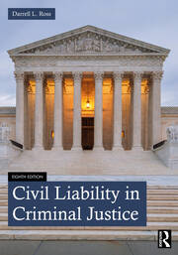
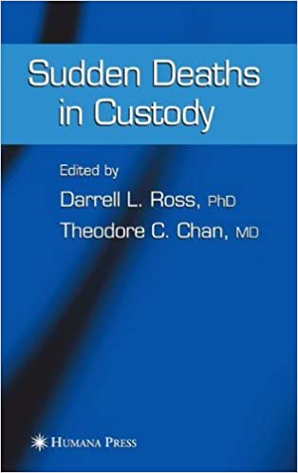
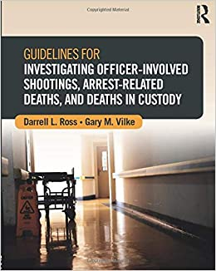
Darrell L. Ross, Ph.D., CJ Professor Emeritus
‘73- ‘85—MI DOC: CO; Unit Mgr. PP Agent; & Acad. Instructor
‘85- ‘92—FSU—CJ & Academy Instructor
‘92- 06—ECU—CJ program & Instructor @ NCJA
‘06- ‘10—WIU—Dir. of LEJA
‘10- ‘24—VSU—Dept. Head & Director of CASS
‘86—‘14—PPCT, Staff & Dir. Research
10 Instructor certifications & 7 prof. associations
120 publications & 5 books
Over 800 training/conference presentations
  30 states & 5 countries
Over 1,000 cases retained as expert witness [Civil/Criminal]
Consultant to numerous CJ agencies, military, & corporations

Slide 4
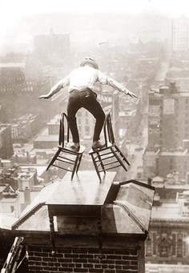
Supervisor Role
Balancing act:
  Demands of Chief or Sheriff
  Demands of the agency
  Demands of officers
  Community expectations
  Role often ambiguous
Responsibility with employees:
  Lead, train, implement & enforce policies & practices, direct, & supervise
  Develop, mentor, coach, monitor, evaluate, feedback, discipline, & hold accountable
Direct & Mitigate
A failure to supervise = abuse of government power
  Legal & Liability issues/expectations
Great expectations

Slide 5




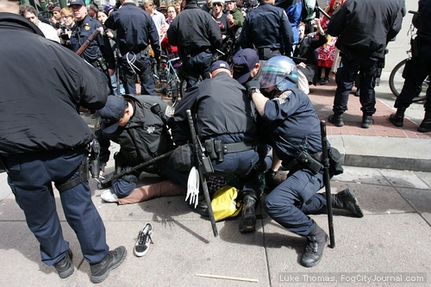
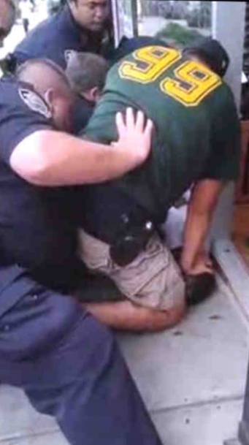
External Sources of Change Internal
Public & Media
Legislature (State/Federal)
  Policing Reforms/Acts
Prosecutor (State/Federal)
Plaintiff’s Attorney
DOJ Investigations
City Council & Mayor
Judicial/Case Decisions
Pundits
Professional Associations
Officers
Supervisors
Unions
In-House Council
Risk Manager
Chief
Image & Branding

Slide 6
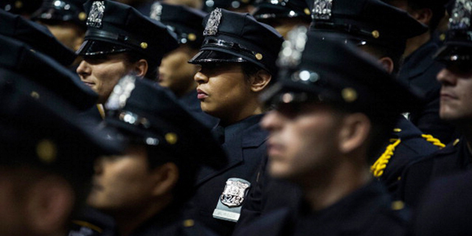
LEOs Expectations of Leaders (Police 1-Survey: 20 & 21)
65%→ job satisfying; 60%→ believe poor agency leadership
77%→ low morale in agency
54%→ do not receive regular feedback from supervisor
35%→ supervisor good role model; 30%→ supervisor not a good role model
49%→ supervisor treats officers fair
50%→ believe supervisor cares for them
30%→ rarely receive recognition for good work
58%→ supervisor shares important information
45%→ plan on leaving agency within 3 to 5 years
55%→ would not recommend the job to another
84%→ support a policy → Duty to Intervene

Slide 7
Elevating Leadership
A quintessential feature of leadership is leading change…
Challenging times requires extraordinary execution of administrative leadership

Slide 8
Course Goal and Themes
Competent &
Confidence
Liability
Issues
Leadership Role
Risk Mgt.
Strategies

Slide 9
Supervisory Liability Questions
How familiar are you with the legal aspects of the job?
What are theories of supervisory liability?
What are the mechanics of a §1983 legal action?
What are the elements of supervisory liability?
What standard (s) do the courts use in supervisory lawsuits?
In what employment areas are employees plaintiffs?
How do legal decisions inform agency policy?
What is the status of your agency’s policies/procedures? Current?
Are P/P’s implementation monitored & evaluated in the field?
How well do you know your employees?

Slide 10
Supervisor Liability Questions
How would you assess your training and preparation to be a supervisor?
How effective are you with leading & supervising your employees?
How current are agency job descriptions?
Are supervisors trained in the agency’s performance evaluation instrument?
Is there an effective system which investigates officer misconduct?
Does department have an early warning/intervention system for employees?
Describe the status of ongoing training in the department
If sued tomorrow, is the department in the “best position” to defend against the lawsuit?
A primary objective for administrators and officers is to proactively work to accomplish this imperative and to work to place the department in the best position to defend against civil litigation

Slide 11
SCOTUS—Vance v. Ball St. University (2013)
Responsibility to supervise subordinates (Linked to failure to direct & train)
“Supervisor is one who assigns or reassigns duties of a subordinate
  Assigned to take tangible employment actions—making decisions impacting the work organization;
  Oversees an employee’s performance;
  Evaluate an employee’s performance;
  Promotes or transfer & Discipline”
How competent are department supervisors?

Slide 12
Competency-Based Administration & Leadership
Admin. Competencies: Planning; Organizing; Staffing; Directing; Coordinating; Budgeting; & Reporting (Gulick & Urwick, 1937)
Administrators exhibit Action-Oriented Leadership
Are forward thinking & continually analyze organizational effectiveness
Promotes open channels of communication
Provides guidance to all personnel, keeps policies current & knows strengths/weaknesses of employees
Keeps current on job education and training (Legal & Administrative practices)
Develops employees for each position & provides supervision & feedback
Keeps employees performance at high level & accountable
Knowledgeable of legal responsibilities & works to mitigate liability exposure
Incorporates Risk Management strategies & data driven decision-making

Slide 13
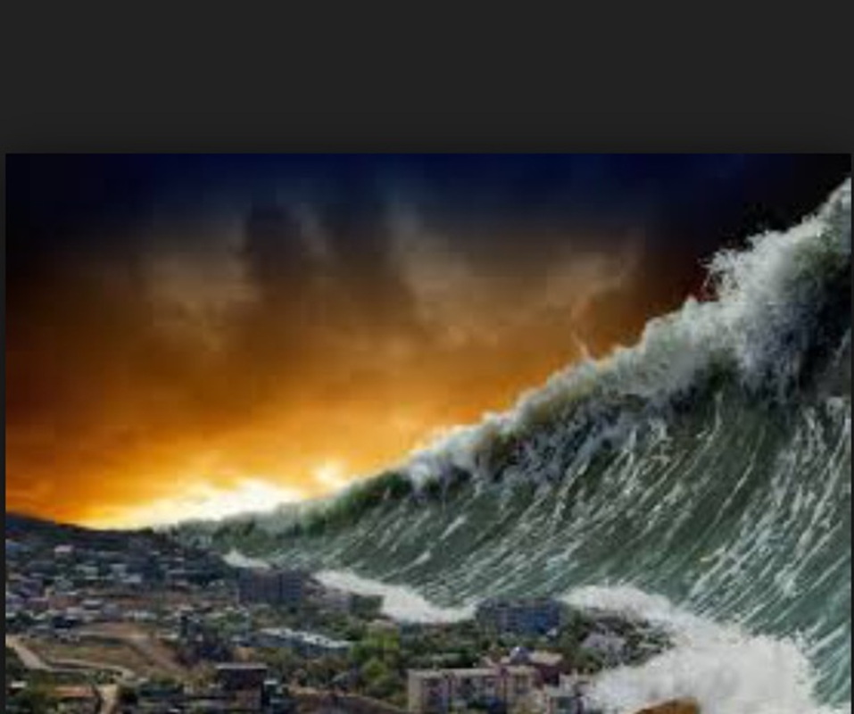
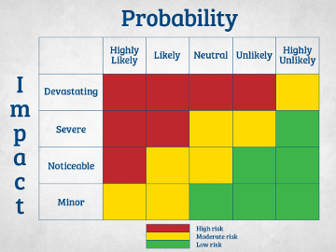
Risk Management Mindset
Ongoing process to assess risk exposure by:
  ID/Analyzing: incidents; events; hazards, & practices
  Assessing losses
  Assessing CFS & Activity logs
  Assessing special operations & De-briefing
  Performing audits and inspections
  Assessing laws; standards; complaints; budget; & resources
  Assessing litigation trends & payouts
  Assessing scientific & field research
  Assessing evidence-based practices
  Assessing by Frequency, Severity, & Criticality index
  Assessing predictability & foreseeability
  LF/HS; MF/MS; & LF/LS → impacts decision making
  Prioritizing risks
  Develop, implement, & monitor risk control strategies
Risk Management Assessment:
Mitigating the LE Tsunami

Slide 14
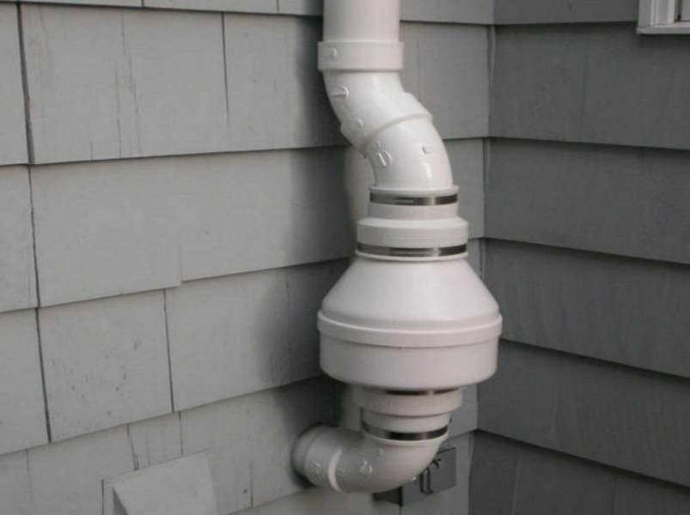
Risk Control Strategies
Risk Avoidance
  Stop a practice or consolidate duties
  Prevent frequency of loss causing event
Loss Reduction (Mitigation)
  Efforts to minimize the loss
Segregation of Resources
  Duplication of resources
  Store equipment at separate sources
  Contingency planning
Risk Transfer
  Transfer or move the activity to another or other agency
  Controlling risks

Slide 15
Risk Control Strategies
Training
  All employee positions
Field Implementation
  Supervisor implements policies and practices
Monitoring
  Supervisor enforces proper application
  Accountability
Collect Data
  Develop mechanism to collect organizational data
Evaluate (D³) Data Driven Decisions
  Regularly assess data collected
  Reports
  Make more informed decisions, policy revisions as warranted, & training

Slide 16
Potential Liability Exposure
Legal & Regulatory
Financial & Administration
R⁴ + TO
Calls For Service/Jail Incidents (N, F, S)
Job tasks/hazards
Citizen/detainee injuries/deaths
Citizen/detainee complaints
LEO assaults/injuries
Operations:
  Specialized teams/Ops
  Critical incidents
Accidents & Workman Comp claims
TTTW&E
Deficient policies/Fail to train
Employee:
  Grievances & Lawsuits
  Misconduct
  Performance Evaluations
  Failure to follow policies
  Failure to follow training
Failing to supervise
Failure to discipline
Failure to investigate
LEO reports
Failure to inspect/audit
Unconstitutional practices

Slide 17
Layers of Liability Protection
Legal Updates &
Risk Mgt.
Practices, Monitoring, & Assessment
Training, Supervision, & Discipline
Leadership, P/P’s, Hiring, Academy, &
FTO

Slide 18
Liability Risk Reduction Model
Constitutional
CJ Agency
SCOTUS
Decisions
Judicial Circuit
Application
DOJ
Investigations
Policy &
Training
Supervision &
Discipline
Qualified Immunity

Slide 19

Potential Legal Scrutiny
State Criminal Prosecution
  Various charges
  Violation of Oath by Public Officer (OCGA; §16-10-1: 1 to 5 yr. Felony)
Federal Criminal Prosecution
  Title 18 USC §241 and §242 (1886)
  Sexual abuse, excessive force and assault & battery
  Average; 8.5 yrs. Prison; $12,000 fine & de-certification
Civil
  State Tort Action
  Federal 42 U.S.C. § 1983, §1985, §1986, & §1988
Title 42 USC §1997 (CRIPA; 1980) [N=100]
  Jails= MOAs=35 & Consent decrees=30
  Prisons= MOAs=20 & Consent decrees= 15
Title 42 USC §12131 (ADA; 1990)
Title 34 USC §12601 (2018; VCCLEA; 1994; §14141) DOJ
  Investigations from 1996 to 2022=50
  Consent decrees= 26 & MOAs= 24
  Administrative failures: pattern & practice of excessive force policies; training; supervision; racial bias; discrimination; no/deficient investigations; no EIS; & deficient discipline , discipline & investigations

Slide 20
Common Litigation Claims & § 12601 Investigations: ‘96-‘21
  Line Officer
False Arrest/False Imprisonment
Stops, Searches & Seizure
Excessive use of Force
Medical Care/Mental Health
Sexual Abuse/Misconduct
Failure to Protect
Emergency Vehicles & Pursuits
Bias Policing
Wrongful Deaths/Arrest-Related Deaths
Special Operations
Failed to Intervene
Diminished capacity of arrestees
Discriminatory practices
  Administrator/Supervisor (PTSD & H)
Deficient Policies
Deficient Training
  Officer & Supervisor
Deficient Supervision Practices
Deficient Disciplinary System
Selection & Hiring Practices
Employee misconduct
Failure to Implement EIS
Deficient FTO program
Pattern of Citizen Complaints
No/Deficient Investigations
Ratified Officer Misconduct
Failure to collect data & assess
Pattern of unconstitutional practices

Slide 21

Top Ten SCOTUS Decisions and Administrative Liability
Policy and failure to direct issues:
  Monell v. NY Dept. SS (‘78); Cty of OK Cty v. Tuttle (‘85); Pembar v. Cty of Cinnci (‘86); Cty of St. Louis v. Praprotnik (‘85); McMillian v. Monroe Co. AL (‘97); LA Co. v. Humphries (‘10); City of Ontario CA v. Quon (‘10)
Selection & Hiring:
  Board of Commissioners of Bryan Co. v. Brown (‘97)
Training:
  City of Canton, OH v. Harris (‘89) and Connick v. Thompson (‘11)
Supervision: Ashcroft v. Iqbal (‘09); Vance v. Ball St. (‘13); Dist. of Col et al v. Wesby (‘18)
Sexual Harassment: Meritor v. Vinson (‘86); Faragher v. Cty of Boca Rotan (‘98); Burlington Ind. Inc. v. Ellerth (‘98); Oncale v. Sundowner Offshore Services Inc. (‘98); PA St. Police v. Suders (‘04)

Slide 22
Top Ten SCOTUS Decisions and Administrative Liability
Employment issues:
  Muldrow v. City of St. Louis, MO et al. (‘24)
  Straub v. Proctor (‘11) [USERRA)
  Skinner v. Railway Labor Exec. (‘89)
  Ntl. Treasury Empl. Union v. Von Raab (‘89);
Wrongful Discharge:
  Cleveland Brd. of Ed. v. Loudermill (‘85)
  City of San Diego v. Roe (’04)
  Bostock v. Clayton Co. (‘20)
Americans with Disabilities Act (ADA, 1990):
  Sutton v. United Airlines (‘99)
Fair Labor Standards Act (FLSA, 1938):
  U.S. v. Darby (‘41); Garcia v. San Antonio Transit Authority (‘85)
  Christensen v. Harris Co (‘00)
Family Medical Leave Act (FMLA, 1993):
  Ragsdale v. Wolverine World Wide, Inc. (‘02)

Slide 23
Common Litigation Claims Against Administrators
Deficient Policies/Practices
Selection & Hiring Practices
Failure/Deficient Training:
  Officer
  Supervisor
  Investigator
Deficient Supervision Practices
Deficient Disciplinary System
Supervisor Failed to Intervene
  Bystander liability doctrine
Sexual Harassment/Misconduct
Deficient FTO program
Pattern of citizen complaints
Pattern of citizen rights violations
Failure to Implement EIS
No/Deficient Investigation
Ratified Officer Misconduct
DOJ, § 12601 Claims
DOJ, CRIPA Violations

Slide 24
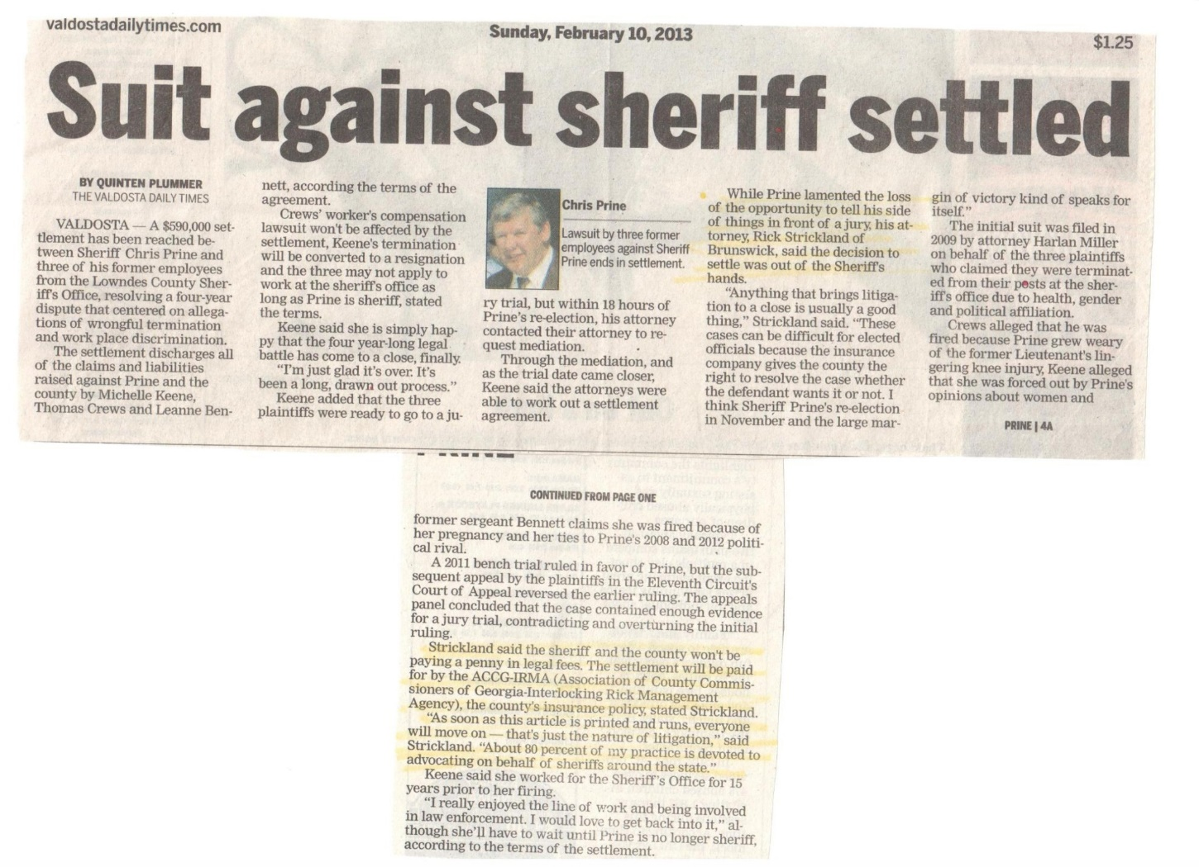
Employee as Plaintiff
Sexual Harassment & Sexual Misconduct
Discrimination
  Gender; Age; Religion; & Sexual Orientation
Unfair Hiring, Promotion &
Retirement Practices
American with Disabilities Act (ADA)
Wrongful Termination
Disciplinary System and Due Process
Fair Labor Standards Act (FLSA)
Family Medical Leave Act (FMLA)
Retaliation
Failure to Train

Slide 25
Outcome Trends of §1983 Litigation (1990—2022)
Lawsuits annually filed (About 60,000):
  About 34,000 against LEOs & 66% settle out of court
  About 26,000 against Jails/DOC & 65% settle out of court (PLRA)
Against Line officer
  Prevail=70%
Administrator/Supervisor
  Prevail=75%
Employee as Plaintiff (22%)
  Prevail= 43%
Compensatory Damages (Carey v. Piphus, 1978)
  Awarded to prevailing plaintiff→ Average award= $425,000.00 (Depends on case type)
Punitive Damages (Smith v. Wade, 1983)
  Awarded in about 4% & average award= $38,000.00
Average Cost to Defend= $325,000.00--> Numerous years; time; meetings, etc.

Slide 26
Civil Liability; Title 42 U.S.C. §1983 Litigation
Most common litigation (KKK Act, 1871)
Provisions:
  “Every (a) Person who, (b) Under color of any statute, ordinance, regulation custom, or
  usage, of any State or Territory, [“Color of Law”]
  (c) Subjects, or causes to be subjected, any citizen of the United States or other person within the jurisdiction thereof to the deprivation of any rights, privileges, or immunities secured by the,
  (d) Constitution and laws, shall be liable to the party injured in an action at law, suit in equity, or other proper preceding for redress
  (Monroe v. Pape, 1961) (Monell v. Dept. of NY Social Services, 1978)
  (Ashcroft v. Iqbal, 2009)

Slide 27

Qualified Immunity
Under attack→ State & Federal level
  8 states have banned or limit QI (IfJ, 4/24)
  Ban→ CO, MT, NV, NM; Limit→ CA, CT, MA, NY
Allow officials to “perform their discretionary duties” without the fear of liability or harassing litigation (Harlow v. Fitzgerald, 1982)
Provides an Affirmative Defense to avoid trial
Provides a shield and protects from liability
Provides breathing room to make reasonable but mistaken judgments
Does not protect plainly incompetent & knowingly violates the law [Pearson v. Callahan, ‘09; City of Tahlequah, OK v. Bond, ‘21 ]

Slide 28
Tenets of Qualified Immunity
Was a Constitutional right violated? [Dukes v. Deaton, 11th Cir. 2017)
Has SCOTUS “Clearly Established Law” on the case issue?
Controlling authority set the CEL on the issue? (Fed. or State SCT)
Circumstances the LEO confronted been clearly defined?
CEL defined with specificity? → Within in the specific context of the case
CEL been defined at an appropriate level of generality?
The incident an “unusual incident?”
Fair notice provided to LEO?
(Brave, 2024)

Slide 29
Tenets of Qualified Immunity
Every reasonable LEO able to interpret case precedent?
Legal principle clearly prohibited regarding the particular situation?
CEL beyond debate? Relevant case precedent & robust consensus?
LEO have Arguable Probable Cause (Malley v. Briggs, 1986)
Court determines CEL
Jury determines whether Constitutional right violated
Agency policy does not create CEL

Slide 30

Qualified Immunity
  Build a position of defense/Hardening the Target:
    Acted within boundaries of the Constitution & SCOTUS decisions
    Acted within State law and Standards?
    Trained to and follow clearly established law?
  How well do you/officers know & follow the law?
  Arguable Probable Cause supports Qualified Immunity
    Acted pursuant to agency “POLICY” ?
    Acted within “SUPERVISORY” direction/guidelines?
    Acted within scope of “TRAINING”?
    Acted within professional education/experience?
    What were the totality of circumstances?
    How would a “reasonable officer act”?

Slide 31



“Defense Shields Up”!

Slide 32
Civil Liability & Administrative Controls
Reduce liability through “Bureaucratic Model”
  Clearly articulated & identified mission statement (w/goals)
  Hierarchy of authority & division of labor
  Command & Control
  Formal & informal communications
  Policy & Procedures
  Ongoing training (Robust FTO/STO) → officers & → Supervisors
  Strong cadre of field supervisors
  Implementation, monitoring, & assessment of field performance
  Delegation of appropriate tasks to employees
  Thorough investigation practices of alleged misconduct
  A system of Early Identification & Intervention
  System of officer evaluation
  Keeping personnel accountable

Slide 33

Agency

Slide 34
Status of Policy Manual?
Have agency policies been written consistent with job tasks & job descriptions?
Have you assessed high liability issues & addressed them through policy?
Have agency policies been written consistent with state standards, legislation, administrative rules & within legal decisions (State and Federal)?
Does the agency engage in a regular formal policy revision process?
How frequently are agency employees trained in the policy manual?
Does the policy training match field performance?
What monitoring & assessment process has been developed to assess field implementation?
Have all supervisors been trained in agency policies and monitor in the field?
What strategies are implemented to ensure officer compliance?
Do your policies reflect Evidence-Based Practices?
If sued tomorrow would your current policy manual withstand a plaintiff’s claim for failing to direct, train, and supervise employees?

Slide 35

SCOTUS—Policy
Monell v. Dept. of Social Services, NY (1978)
  Policies, Customs, Practices, SOPs, GOs, Rules & Regulations
  Created the policymaker category & conduct attributed to the local govt.
  Official policy the “moving force” and agency executive & officer may be liability for damages
City of St. Louis v. Proprotnik (1988)
  Custom→ Unwritten practices which become policy
City of Ontario, CA v. Quon (2010) (involved ERT & workplace policies)
  Develop policy & announce ahead of time
  Broad policy on all communication devices & technology changes
  Employer can control devices authorized & monitor
Los Angeles County CA v. Humphries (2010)
  Reaffirms the Court’s decision in Monell
  Policy the “moving force”
  Money damages may be awarded for incurred liability

Slide 36
Change in Field Ops
Politicalization
Adopt New/Change Tactics
Law & Litigation
Adopt New Technology
Policy
State Standards
Adopt New Equipment
Change in Community
Change in Leadership
Critical Incident
Liability Payout

Slide 37
Case Law & Policy
Law establishes organization authority [Administrative Standards]
Informs policy development & ongoing revision
Establishes legal framework for conduct & place agency in defensible position
Should address 4Cs: Comprehensive, Current, Comprehensible & Constitutional
Guide & direct personnel in lawful aspects of job:
  Places LEO on notice: Groh v. Ramirez (‘04) v. Messerschmidt v. Millender (‘12)
Provides clear direction to guarantee officers lawfully and ethically perform their sworn duties
Provides mechanism for developing practices & training
Informs a court’s analysis on reasonableness of LEO’s use of force
Courts mixed on policy role→ Violations of “agency policies do not establish per se constitutional unreasonableness” [Scott v. Harris, 2007; Boynton v. City of Tallahassee, 11th Cir. 2016]
Underscores Constitutional Policing & Corrections

Slide 38
Role of Agency Policy
Chief’s/Sheriff’s vision operationalized through policies
Organization establishes mission, objectives, & operations based on legal authority
Articulates management philosophy & organizational core values
Delegates authority
Establishes rules and operational procedures
Directs employee performance and task guidance
Provides for discretion when appropriate
Promotes excellence and officer safety
Reduce risk of litigation and first line of agency defense [Risk Mgt.]
Demonstrates a collective sense of purpose to fulfill the mission of the organization

Slide 39
Role of Agency Policy
Defines ethical behaviors and responsibilities
Promotes professional conduct and holds rogue officers accountable
Shapes organizational culture → Describe your agency culture & sub-culture
Supervisors most critical component in shaping and maintaining agency culture
Set the tone and leader as model
Reflection questions:
  Frequency of training/re-training?
  How implemented with LEOs in the field?
  Supervisors regularly monitor?
  Achieving its objective? How do you measure?
  Are supervisors holding the line?
  LEO conduct match policy and training?
  Room for improvement? → What are needed actions steps?

Slide 40
Potential Policy Deficiencies
Outdated/Fail to keep up w/law
Need to know – too much (must simplify)
Guidance not field realistic
Statements vague, ambiguous
Significantly elevated above legal standards
Competing concerns/objectives
Poor training & reviewing with officers
Over-reliance on techniques or Equipment
Handcuffs officers/supervisors
Chief, Sups, & LEOs not on same page
Deficiency in supervision
Failure to enforce in field
Failure to evaluate effectiveness & impact
Failure to check, hold officers accountable
Failure to correct non-compliance
Failure to discipline
Practices fail to match policy & training

Slide 41
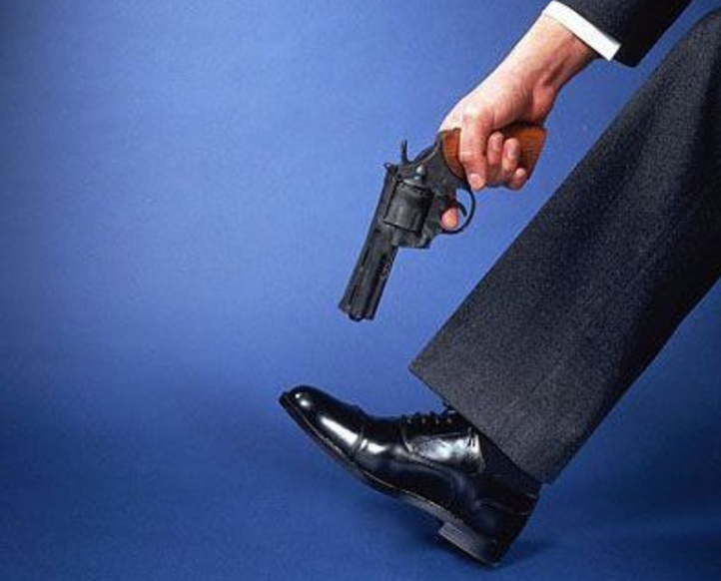
Policy v. Procedures
Policy= Guides officers thinking
  Officially adopted decisions created by agency authorized person (Goebert v. Lee County 11th Cir. 2007)—Wide spread practices
  Provides broad statements & provides a framework
  Establishes priorities & boundaries
  Delegates authority of tasks to positions
  Authorizes accepted TTT’s
  Assists in decision making
  Articulates consequences for non-compliance
Procedures= Guides officers actions
  Guides officers actions in various situations
  Describes methods of operations
  Requirements v. Discretion
  Guides appropriate application of TTT’s
  Allows discretion and reasonable flexibility
Policy and Practice Considerations
Avoid Shooting Yourself in the Foot:

Slide 42
Do NOT Conflate “Guidelines” to “Standards”
DO NOT mix them up!!!
  The “law” requires “X,” [LEGAL consequences]
  Your “department” requires “Y,” [ADMINISTRATIVE consequences]
  You’re encouraged to do “Z”!!!! [NO consequences]
  Professional associations recommends ZZ!! [No statutory mandate]
  These are NOT synonymous, they are NOT the same things,
  DO NOT mix them up, equate, or conflate them.
Encouraged guidelines should not be allowed to be inappropriately equated or conflated to accountability standards with legal and/or administrative consequences.

Slide 43
State of GA v. Robert Olsen (11/1/2019)
When a policy is restrictive and unconstitutional
OIS of an unarmed naked man
Prosecuted
  Aggravated Assault; Violation of Oath of Public Office; & Making False Statement
Immunity Hearing
Jury Trial: Guilty→ Sentenced to 20 years; serve 8 & 12 on Probation
March 12, 2024 → Olsen v. State of GA; 2024WL 1066937
  Conviction reversed based on the violation of Dept. UoF Policy
  Dept. policy in conflict with GA Law [§ 16-3-21]→ Null and Void
  Trial Court Error

Slide 44
O.C.G.A. 1601—Oath of Office
Felony; punishable from 1 to 5 years in prison
“I will faithfully support and defend the constitution of the USA; the constitution of the State of GA; I will faithfully enforce the laws of the State of GA”…… and
“I will faithfully perform all of the duties of my office… and I will faithfully observe all of the rules, orders, regulations of the” ______PD/Sheriff’s Office
Beard v. State, 300 GA. App. 146 (09): CO guilty of violation of oath of office
  Advised inmate to pay him $2,000 to avoid being charged w/possession of MJ

Slide 45
GA State Patrol Oath of Office [No, 3.02-1; 11/8/11]
I, __state your name__ of ___, do hereby voluntarily accept an appointment as a ____ in the ________ agency .
I further swear (or affirm) that I am not the holder of any unaccounted for public monies due the United States, this or any other State, or any political subdivision or authority thereof.
I swear (or affirm) that I am not the holder in any office of trust under the government of the United States, any other state, or any foreign state which I am prohibited from holding.
I swear (or affirm) that I am otherwise qualified to hold this office according to the Constitution and laws of the State of Georgia.
I swear (or affirm) that I will faithfully perform and discharge the duties of my position to the best of my ability and without malice.
I swear (or affirm) that I will support and defend the Constitution of the United States of America and the Constitution of the State of Georgia,
SO HELP ME GOD.

Slide 46
Risk Mgt.→ Implementation & Monitor
A critical role of supervisors
Connects with supervisors directing, training, and evaluating officers
Implement Data Tracking system
  Aligns with: Research→ Info→ Decisions→ Policy/Practices→ Training→ Field Application→ Outcome (s)
Remind/Review at roll calls
Remind when full implementation starts
Purpose to personally observe officer field response
Review officer reports and video/BWC
Monitor policy field execution
Discuss/interview officers regarding their perception of implementation
Remediate as warranted
Rebuffs claims of failure to supervise

Slide 47
Data Collection, Assessment, & Decision Making
Analytics→ “You can’t manage what you don’t measure” (PERF, ‘21)
“You can’t solve a problem, unless you diagnose the problem first” (Bush, 2009)
“Data Driven”→ Data Tracking/Reporting System→ multiple sources
Underscores System Approach/Thinking
Proactive Risk Management
Collect, evaluate, & interpret data outcomes
Compare outcomes & describe impact:
  Trends & Patterns
  Policy Implications
  LEO performance
  Pinpoint emerging issues/problems
  Informs training and supervision practices
Collect, Assess, Interpret & Report
CFS/Arrest/Force Options
Circumstances
Location & Environment
Subject behaviors, condition, and resistance
Officer(s) response
Force options applied
Subject injuries
LEO injuries
Data informs critical decisions

Slide 48
Compliance w/ Policy
Supervision responsibility & fulfills supervising and guiding officers = Risk Mgt.
Connects with field monitoring and field observation
Continual Re-enforcement of policies (Station House & Field)
Assess officer decision making
Track officer injuries, accidents, & workman comp claims
Assess civilian/detainee complaints
Determine if training & field execution match policy
Determine officer comprehension and hold accountable
Feedback to officers→ Find opportunities to praise proper conduct
Remediate and correct early (EIIS)
Provide re-training as appropriate
Progressive discipline

Slide 49
Minimal Topics for LE Policy Manual
Assess: research; model policies; contact experts; legal
Written & mirror philosophy of agency
Reflect Legal Decisions & State standards
Minimal Topics (not exhaustive):
  All operations Agency Jurisdiction
  Administration and Management Training
  Conduct & Professional Standards Arrest
  Use of Force, Weapons, & Restraints Vehicle Operations
  Property Evidence Investigations
  Communications Special Operations
  Patrol Functions People in Crisis
  Officer Safety & Wellness Uniform & Dress Code
  Records Traffic & Parking
  Crime Prevention Recruitment & Selection
  Personnel Critical Incident Management
  Title IX Body Worn Camera & Video
  Canine Detainee Processing & Transportation
  Pursuits Emergency Management

Slide 50
Minimal Topics for Jail Policy Manual
Assess: research; model policies; contact experts; legal
Written & mirror philosophy of agency
Reflect Legal Decisions & State standards
Minimum policy areas (not exhaustive):
  Administration/Management Fiscal Management
  Personnel & Training Detainee Records
  Safety & Emergency Security & Control
  Sanitation & Hygiene Food service
  Medical/Mental Health Care Detainee Rules & Discipline
  Communications Detainee visits
  Admission/Release of Detainees Classification & Housing
  Property control Detainee programs/services
  Suicide detection Special operations
  Response to emergencies Response to Resistance
  Special Management & Admin. Seg.

Slide 51
City of Ontario, CA v. Quon, (2010)
City contract w/company for 20 pagers & issued to ERT members by Chief
Dept. policy= monitor w/without notice; treat as emails & officers read & sign no expectation of privacy
Sgt. Quon, exceeded limit, placed on notice by Lt. & Quon paid overages but failed; messages checked for two months by IA; & found 456 messages; 57 non-work related & many w/sexual content
Quon filed suit for 4th Amendment violation
Court: examine privacy expectation in communication made on electronic equipment issued by employer

Slide 52
City of Ontario, CA v. Quon, (2010)
Issues:
  Did Quon have a privacy expectation?
  Did review of messages constitute a search?
  Do searches of electronic equipment have same protections like physical property at work/office?
No 4th Amendment right violation & aware of policy (9-0 vote)
Signed waiver form → reasonable to monitor & employer maintain integrity & no warrant needed
Policy Implications (Risk Mgt. Line of Defense):
  Develop policy & announce ahead of time
  Broad policy on all communication devices & technology changes
  Employer can control devices authorized & monitor

Slide 53
Risk Litigation Reduction Model—Policies
Review/Revise on a 2--year cycle
Keep Current on Legal & Liability
Keep Current on LE Practices
Ongoing Review/Revision of P/Ps
Reflects current status of the law
Full review after a critical incident
Revise when operations change
Revise when equipment and
technology change or added
Manufacture’s guidelines
Supervisors on Same Page
Supervisors Trained/Updated
Instructors Trained/Updated
Officers Trained/Updated
Test for Competency
Supervisors:
  Field Implementation
  Monitor field application
  Assess Field Applications
  Evaluate/Performance review of officer field application
  Enforce & Hold officers accountable
  Officer compliance
  Routine Inspections
Places agency in best defensible position
Assists in establishing Qualified Immunity

Slide 54
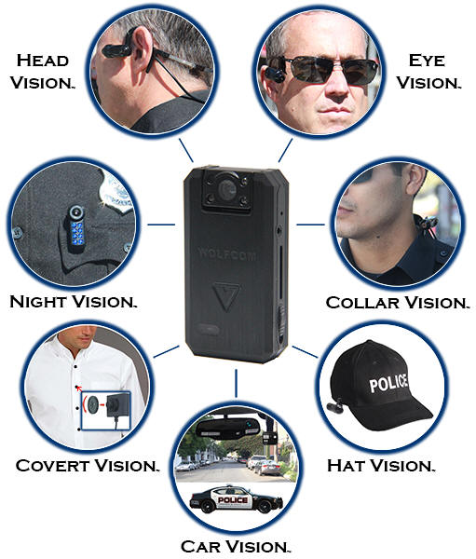
BWC Hardware (www.Wolfcom)

Slide 55

BWC & Video—Policy/Practice
Emergence of technology
Adoption & Benefits
  Document probable cause for arrest
  Behaviors of LEO & Citizen (mixed/limited effects; Lum, 2020)
  Incident documentation
  Evidence (Scott v. Harris, 2007)
  Officer evaluation and training
  Most likely to prevail in litigation= 77% (Zamoff, GLR, 2019)
Policy & Practice
  Usage & Procedures
  Restrictions
  Storage & Retention
  Training of officers
  Officer and Supervisory responsibility
  Release in accordance with law
  Investigation

Slide 56
Limitations of BWC
Do not tell the whole story or circumstances
Cameras do not follow your eyes or see as they are
Cameras lack: vision; emotion; thinking; perception; & memory
Important danger cues can’t be recorded
Camera speed differs from the speed of life
Camera may see better than a person in low light
Your body may block the view
A camera only records in 2-D
Do not record physiological and psychological responses [Human Factors]
One camera may not be enough
A camera encourages second-guessing
A camera can never replace a thorough investigation
Not the total answer or the full panacea→ Not ultimate truth

Slide 57
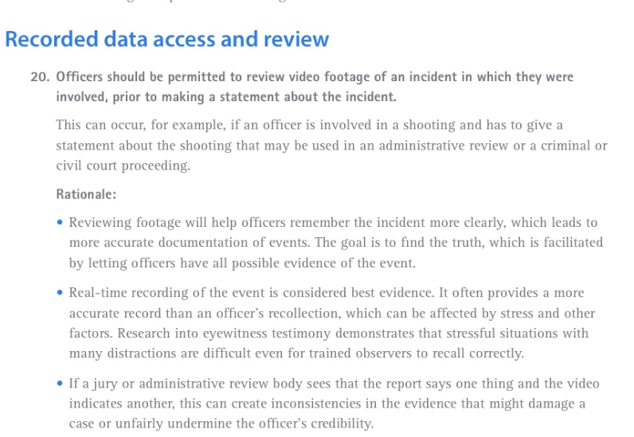
BWC Policy Issues
Debate → Review v. No Review
Video one part of the evidence → A resource
Other contexts view videos for accuracy
Avoid hindsight bias → Avoid the GOTCHA!
Many agencies:
  Allow LEO to view video
  Write and submit report
  Interview (24 to 72 hours)
Some departments→ write report and no view video, but others:
  Write report & view video
  Write supplemental report
  Interview

Slide 58
Hiring & Selection
SCOTUS: Brd. of Comm. of Bryan Co. v. Brown (1997)
Deputy used force during arrest, caused knee injury to arrestee
Excessive force claim & deficiencies in hiring process
Suit claimed deliberate Indifference in hiring
SCOTUS held:
  Fight in college not a propensity for violence
  Sheriff’s hiring policy not the moving force
  Liability not dependent on a mere probability—must depend on a high strong probability that an officer would inflict an injury to connect to screening & hiring
  Must examine the entire file & not one incident
  A single act generally not sufficient to create liability
How would you describe your hiring process?

Slide 59
Checklist in Hiring
Work with HR
Training of supervisors
Follow P/P
Job announcement
Application form (retain on file)
  Gaps in work history
  Education
  Vague statements
Background checks
References
Interviews
  Traditional
  Behavioral
  Job specific
  Off limit questions
ADA issues
Tests
Conditional job offer
Physical exam after offer
Psychological assessments
Job offer, Terms/Condition

Slide 60
Consent Release Forms (general)
Substance abuse screening
Credit history
Criminal history
Fingerprints
Driving record
Employment history
Education history
Medical records
Personal information
Polygraph
Written/reading examination
Physical ability Testing
Contact references
Oral review board
Interview w/chief
City manager

Slide 61


Slide 62
Sexual Harassment
10/19: Female CO awarded $200,000, sexual harassment & retaliation, MO
6/15: $270,000 settlement for hostile work environment, WV
2/15: $350,000 settlement with a sergeant sexual harassment & gender discrimination, VA
12/14: $325,000 settlement claiming sexual harassment & retaliation, WA
2004: $600,000 awarded to a female officer as her Lt. failed to respond to claims of harassment from her Sergeant, Houston, TX PD

Slide 63
Sexual Harassment Litigation Trends
EEOC: 1997 to 2021
  Annual average filings=12,000 (28%) Average annual awards $59 million
  TX, FL, & GA lead the way
  Claims increasing: sexual orientation & gender identity rights in workplace
Law Enforcement claims/Issues (Police 1; Dwyer, ‘21)
  Average jury award= $1,160,835 v. Average settlement award= $389,431
  HR manager treats→ He said/she said and dismisses
  Supervisor frequently the harasser
  Supervisor attempts to talk reporting officer out of filing complaint
  Reporting officer retaliated against
  Reporting officer is transferred

Slide 64
Sexual Harassment
Defined (EEOC, 29 C.F.R. § 160.4.11, 1995):
  Unwelcome sexual advances; requests for sexual favors; other verbal or physical conduct of a sexual nature
Factors:
  Conduct is a term or condition of employment
  Conduct a basis for employment decisions affecting the person
  Conduct interferes with employee’s work performance
  Conduct creates intimidating, hostile, or offensive work environment
Quid pro quo
  Supervisor conditions an employment benefit or continued employment for sexual behaviors
  Tangible employment action

Slide 65
Sexual Harassment
Hostile or offensive work environment→ sexually related:
  Jokes; suggestive remarks; graffiti; photos/posters; cartons; physical interference; touching; etc.
  Texts→ Sexting; sending obscene photos
  Constructive discharge & Tangible employment action
  Intolerable and unbearable working conditions → Abusive working environment
  Must be severe and pervasive to alter person’s employment condition
  As a result, resignation qualified as a fitting response
Question: Working conditions so intolerable a reasonable person would have felt compelled to resign? (NLRB, 1931)

Slide 66
SCOTUS on Sexual Harassment
Title VII, Civil Rights Act of 1964—unlawful to discriminate on basis of sex
Employer may be sued on claims of sexual harassment
Meritor v. Vinson, 477 US 57 (‘86)
  Hostile work environment actionable under Title VII
  Must be unwelcome & sufficiently severe or persuasive
Burlington Industries, Inc. v. Ellerth, 524 U.S. 742 (1998)
One who refuses unwelcome & threatening sexual advances of a supervisor, with no adverse, tangible job consequence, may prevail
Justice Souter noted: Title VII’s purpose not to provide redress but to avoid harm
Faragher v. City of Boca Raton, 524 U.S. 775 (1998)
Policies must not only be in place but must be enforced—policy not disseminated to employees

Slide 67
SCOTUS on Sexual Harassment
Oncale v. Sundowner Offshore Services, Inc., 523 U.S. 75 (1998)
Same-sex harassment is actionable under Title VII
Established rules:
    Whether employer has actual or constructive knowledge of environment
    Whether employer permitted the environment by failing to take appropriate preventive steps
  Liability for harassment can incur even if an employee is otherwise treated well
    A manager can be held responsible for a harasser’s actions – unless a department has a strong system of dealing with problems
    The harasser must inform a decision-maker of the harassment
    A department must have an effective policy in place, disseminated to all employees, enforce the policy and
    Thoroughly investigate complaints of sexual harassment promptly

Slide 68
Dept. of State Police of PA v. Suders, 542 U.S. 129 (2004)
Female dispatcher quit due to supervisor harassing her & hostile environment
Harassment from three supervisors over several months
  Repeated sexually explicit comments and gestures
  Obscene and sexually offensive comments and posting vulgar photos
Requested help from PSP’s EEOC officer—never filed complaint as instructed
Set up and arrested for “stealing” job exams & quit
Filed suit, for sexual harassment and “constructive discharge”
Lower court found in favor of the PSP and Third Circuit Court reversed:
  Questions emerged about the “effectiveness” of the PSP’s policy and program
  Constructive discharge, if proved equals a tangible employment action
  Liability could attach

Slide 69
Dept. of State Police of PA v. Suders (2004)
The Court examined whether “constructive discharge” is a “tangible employment action”
Court 8 to 1 held:
  Intolerable work environment making employee resign can be construed as a constructive discharge
  Employer has a defense of accessible policies in place
  Employee failed to take advantage of policies
  No defense for employer if employee could show reason to quit resulted from a employer sanctioned adverse action resulting in change in employment (demotion, cut in pay, reduction in benefits, transfer, or denial of promotion)
  The Court remanded back, because Suders never followed the policy

Slide 70
Risk Management/Risk Control & Take Action
Assess your agency culture
  Hostile work environment—most common form
  Danger of Claims of Retaliation and Gender Discrimination
Develop/revise policy, consistent with SCOTUS decisions
  Work w/HR
  Disseminate policy
Train
  Supervisors in policy and supervisory issues
  All LEOs
  Investigators
Implement a process for reporting and making claims (Sup.; HR; other Sup.; or hotline number)
Monitor and enforce → A “zero tolerance” policy
Investigate

Slide 71
Risk Management/Risk Control & Take Action
Supervisors implement & enforce policy
Demonstrate reasonable measures taken
  Maintain professional work climate
  Measures to prevent
  HR Investigate all claims
  Take corrective action
  Documentation
Two prong
  Punishment
  Future of Prevention
Due diligence to avoid appearance of
  Hostile work environment
  Retaliation
  Gender discrimination

Slide 72
Brantley et al. v. City of Jessup, GA, No. 2-21-cv-12 (2021)
Three female officers filed suit and claimed the chief sexually harassed them
The officers claimed the chief created a sexually charged work climate
Alleged, chief reminded them, “owed the chief sex” for giving them a job
Asserted the chief made work intolerable:
  Repeated lewd comments
  Repeated unwanted physical touching of the officers
  Repeated requests to join him at the City Manager’s cabin for sex, which they refused
Claimed the city manager would not enforce the policy
Officers resigned due to the chief’s conduct & work climate
Outcome?

Slide 73
Sturdivant v City of Atlanta, Chief Turner & Ludwig
(11th Cir.’15)
Sgt. Sturdivant—Asst. Commander of HR
Over 3-4 months, Sgt. Ludwig sent texts to Sturdivant
One day sent message about her body—then a photo of his erect penis– “Thinking of You”
She complained to OPS & OPS interview Ludwig about 2-3 days later & told Ludwig no contact with her—he stopped sending messages
OPS did start official investigation after 30 days & she complained to Chief—Investigator--> “its just Sturdivant, she’ll get over it”
10 months later Ludwig found guilty of violation of Policy—1st offense & suspended 10 days per policy

Slide 74
Sturdivant v City of Atlanta, Chief Turner & Ludwig
(11th Cir. 15)
Sturdivant filed § 1983 gender based claim:
  Practice of discouraging female officers to file SH claims
  Failing to promptly investigate claims
Court found:
  PD had policy
  Training provided & Ludwig’s first offense
  No widespread practice of abuse
  OPS was contacted & investigation conducted
  Ludwig had complied & Disciplined within 10 months
  No supportive facts
  No evidence that delay based on gender or deliberately indifferent

Slide 75

Supervisors: First Line of Defense
& Quality Control

Slide 76
First Line Supervisor
Significant leadership style is “Serving” others→ Servant Leadership
Leaders also responsible for building high performing personnel
Ralph Nader: “Function of leadership, to produce more leaders, not followers”
Great leaders are great trainers
Creates a culture of “We & not Me”
Leaders foster a system to develop and prepare others to lead
What makes a great supervisor/leader?
How do you measure?

Slide 77
First Line Supervisor
Agency key position:
  Supervise and direct 85% of agency personnel
  Supervisors are conduit of Chief’s policies and implement/enforce
  Chief relies on supervisor to lead patrol operations
  Extension of the Chief in the street
  Serves as agency early warning system
  Agency first line of defense

Slide 78
Supervisor Competencies and General Duties
Comprehends and ensures agency vision/goals/policies operationalized
With LEOs→ face of the agency
Leader and directs team
“Leads from the street/cell block”
Ensures policy and training match performance
Planning, scheduling, & assessments
Decision making & data driven decisions
Reporting & evaluate reports
Technical, Tactical, & Technology (K→S→A)
Inspections and compliance
Work w/other supervisors
Risk manager/Risk mitigation
Takes/investigate citizen complaints
Critical thinking skills
Executes legal responsibility & Liability gatekeeper
Crime Reduction/Prevention strategies
Responds to critical incidents and emergencies
Model ethics & leadership
Listen & Communicates
Problem Solver & Resolve Conflict
Cultural architect
Motivator/Inspirer
Develop others: Trainer/Coach/Mentor
Evaluate/Correct/Praise/Reward LEO
Hold LEO accountable
Human Relations & Personnel issues
LEO safety & wellness
Broker of resources
Engages community
Media relations

Slide 79
Developing First Line Supervisors
Two important times in any organization
Promoted as a “peak performer” and demonstrated leadership potential
Frequently training lacking and frequently no systematic approach
Research shows:
  25% report adequate in transition from LEO to supervisor
  85% received no formal training prior to assuming duties
  60% under performed the first year
How do you prepare supervisors to:
  Lead (develop a leadership philosophy)
  Know what is expected as the supervisor
  Perform job duties
  Evaluate job performance

Slide 80
Need for Field Supervisor Training Program
Transitioning to the new job is critical
Police 1 survey (2022):
  23%: internal leadership training program
  65%: no internal leadership training program
Develop a formal structured systematic process → similar to FTO
Designed to provide guidance in supervisor role and job duties:
  Onboarding
  Develop supervisor field manual; standardized curriculum; and evaluation
  6 Phases (multiple phases; multi-methods; multi-evals; & multi-evaluators)
  Supervisor Training Academy (96 hours) with exam and evaluation
  Field Supervision Training (12 weeks) with evaluations
  Scenario-Based Training with evaluation
  Meets with Chief and other commanders regularly with evaluation
  Rebuffs, claims of: failure to direct, train, or supervise → Fulfills leadership responsibility
  Documentation

Slide 81

Field Supervisor Training Phases
Probation 12 months (3.5/8.5)
P1 Supervisor Academy (40 hours)
    Evaluation & Exam
P2 Field (6 Weeks)
    Weekly evaluations and Phase #2 Evaluation (P1 & P2)
P3 Supervisor Academy (40 hours)
    Evaluation & Exam
P4 Field (6 weeks)
    Weekly Evaluations and Phase #4 Evaluation (P3 & P4)
P5 Unit Supervision (8.5 months)
    Monthly evaluation by command
P6 Supervisor Academy (16 hours)
    End of probation
    Final evaluation P1-P6

Slide 82
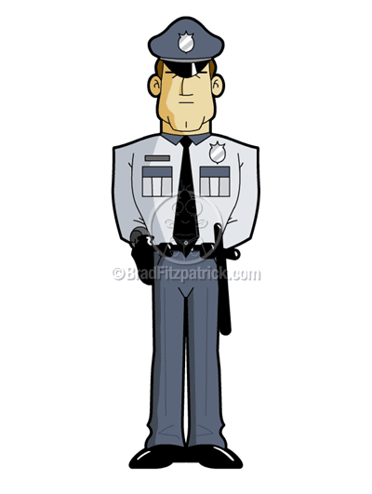
Ashcroft v. Iqbal, 556 U.S. 662 (2009)
  11th Circuit’s Application Of Iqbal
  Implements an unconstitutional policy (see Olsen v. State of GA; 2024)
  Direct participation in constitutional violation (personal misconduct)
  Personally directs an officer in an unconstitutional act
  Must have actual knowledge and failed to remedy or address the problem→ “Constructive Notice”
  May be held liable for Action/inaction; rises to “Causation” (§1983 language)
    Directly traceable to the supervisor→ Affirmative linkage
    “Deliberate Indifference” → the “Moving Force”
    Aware of past patterns of violations & deliberately chose to ignore it
  A supervisor acting with deliberate indifference to actual or constructive knowledge of a constitutional wrongdoing has “caused a person to be subjected” to a constitutional rights violation in accordance with §1983
  Such actions demonstrates abuse of power of the position and subjects that person to personal liability

Slide 83
Failure to Supervise
Unconstitutional conduct by the supervisor;
Supervisor on notice through actual or constructive knowledge;
Liability not actionable unless the supervisor either encouraged the specific incident of misconduct or in some other way directly participated in it;
Supervisor implicitly authorized, approved, or knowingly acquiesced in the unconstitutional conduct of the offending officer (s);
Is there a causal connection between the defendants’ wrongful conduct and the violation alleged?; and
Failure to supervise and discipline LEOs amount to ratification?

Slide 84
Supervision Questions
Supervisors knowledgeable and competent in:
  Criminal Law
  Civil liability
  Agency Policies and Practices
  All tactics, techniques, special weaponry & equipment
  Leadership principles and application
  Conflict management
  Evaluate incident & Team performance
  Monitor & assessment of field incidents
  Assessing training of the Team
  Evaluating LEO performance
  Holding officers accountable

Slide 85
District of Columbia, et al. v. Wesby, et al. (2018)
Sgt. directed officers to arrest party goers on premises illegally
They claimed had permission & filed § 1983 for false arrest/imprisonment & failure to supervise
On direction of AG’s office; LT changed charges to disorderly conduct
Sgt. complied but disagreed w/charges
SJ/QI was denied at District & DC Appellate Court—SCOTUS reviewed
Decision:
  Officers had PC to arrest; reversed & granted officers QI
  Failure to supervise claim failed & QI granted
  No improper direction by sergeant
  Goes to competency of sergeant

Slide 86
Forrest v. Parry, Stetser, & City of Camden, NJ, et al. (‘19)
LEOs kicked in doors at residence looking for drugs; beat suspect unconscious
Cuffed, drug down stairs, transported to hospital, & treated for severe injuries
LEOs falsified reports, GJ indicted, & suspect sentenced to 4 years in prison
Suspect filed 2 complaints & no IA investigation or response & filed § 1983 claim
18 months later, LEO admitted falsified reports & he, two other LEOs, & 1 Sergeant investigated & led to a DOJ civil rights investigation
Suspect released

Slide 87
Forrest v. Parry, Stetser, & City of Camden, NJ, et al. (‘19)
DOJ investigation found:
  Officers routinely planted drugs, false reports & 200 cases were dismissed/vacated
  PD investigated by NJAG 5 times & referred to Prosecutor for oversight→ “Warned”
  Over 350 complaints of LEO misconduct backlog in IA & deficient investigations
  About 1% of complaints sustained (EF, ISS & FA)
  Chief & supervisors knew of officer misconduct: failed to intervene/failed to supervise
  LEOs knew supervisors turn “blind eye” to their misconduct
Third Circuit Court QI
  Deficient policy
  Failure to train/supervise
  Deficient investigation

Slide 88
Helm v. Rainbow City, AL (11th Cir. 2021)
Concert, teenage female had seizure & multiple LEOs notified (Chief & 5 LEOs)
LEOs claim told “female out of control”
LEOs held, she jerked & 1 LEO warn CEW
DS mode applied—Alert & blackout 2-3 x & Chief leave & called EMS
LEO used CEW 2 more x, in DS mode while other LEOs restrained
Mom arrived, approached, tackled & she CEW by another LEO—arrested; jailed & charges dropped
§1983 claims filed: Excessive force; Fail to intervene;
  False arrest/Imprisonment
  Medical care
  Failure to train & supervise
Crt. applied Graham factors
During grand mal seizure, held by 4 male LEOs, and CEW 3x in DS mode during a medical emergency
No crime; no threat→ medical emergency
LEOs agree: no crime, no threat or resisting not disorderly & no disobey or threaten LEOs
Claims:
  False arrest/imprisonment
  Force/Quantum of force
  Failure to intervene
  Medical care
  Failure to supervise
  Failure to train

Slide 89
Covington v. City of Madisonville, TX (5th Cir. 2020)
Sergeant of PD, planted meth in former wife’s vehicle
Fabrication of evidence led to arrest & loss of custody of children→ Charges dropped
Sergeant indicted & convicted
§ 1983 suit claimed:
  Fabrication of evidence; false arrest; & loss of her children
  Deficient policy; inadequate screening; failure to supervise, investigate, & ratified conduct
  Deliberate indifference to obvious misconduct
Court determined:
  Hiring/screening process adequate
  No proof of tolerating a widespread practice of misconduct or ineffective supervision
  Denied SJ→ failed to investigate when placed on notice of conduct
  Led to ratifying the sergeant’s conduct & supported liability against chief

Slide 90
Questions for Supervisors??
Who you are hiring?
Supervisors properly trained?
Implement & enforce policy!
Officers competent in P/Ps?
Time spent w/officers?
Officers current in training for their job assignment?
Monitor officer field performance?
Frequency of field performance?
Review videos? Review reports?
Performance evaluations?
Provide corrective action as warranted
Fit for duty?
Feedback? Coaching/Counseling?
Early Identification & Intervention System
Follow through on complaints?
Keep officers accountable?
Know & implement agency progressive discipline process
Ignore nothing, follow through, & document actions
Deficiencies? Retrain as necessary
Find officers doing things right !! Praise/Reward/Reinforce Quality Performance

Slide 91
Litigation Risk Mitigation Model →Supervisors
Chief & Supervisors on same page
Support Policy & Training
FTO program & STO program
Current on Legal Issues
Job Competency
Supervisor as Trainer/Leader Mindset
Implement & Enforce Policy
Monitor officer field performance
Reviews BWC/Videos, & LEO reports
Provide Debrief & Feedback
Review citizen complaints
Early Intervention System (EIS)
  Progressive Discipline Process
Perform LEO evaluations
Find officers doing things right !! Praise/Reward/Reinforce Quality Performance
“Breakfast of Champions?”
Hold officers accountable
Promote Officer Safety & Wellness

Slide 92
Annual Training & Career Development
At least 20-40 hours annual supervisor training (specific)
Advanced supervision training & encourage higher education
Provide feedback to LEOs and supervisors regularly
Keep current on national & local issues
Encourage growth in leadership & seek special assignments
Carve out an expertise
Sgts. as DT Instructors & First Responders
Community engagement
Encourage continual readings in leadership and supervision
Evaluate supervisors annually

Slide 93
Supervisor Liability—11th Circuit
Franklin v. Curry (11th Cir. 2013): Liability can attach against a supervisor who personally participated in the incident→ No supervisory liability
Keith v. DeKalb Co. GA, 749F. 3d 1034 (11th Cir. 2014)
  No failure to train & SJ awarded
Jones v. Fransen, Towler, Ross & Gwinnett Co., 857 F.3d 843 (11th Cir. 2017)
  No excessive force when K-9 used
Perez v. City of Sweetwater, Duarte, et al., 770 Fed. Appx 967 (11th Cir. 2019)
  No deficient policy; no failure to train; & no failure to investigate
Forrest v. Parry, et al. (3rd Cir. 2019): Custom/culture of LEO/Sup. misconduct
  FA; EF; DPP; FT; FTS; FD; FI—Denied SJ

Slide 94
Supervisor Liability—11th Circuit
Mann v. Taser, Intl, Inc. (11th Cir. 2009)
  Supervisor may be held liable when the supervisor personally participates in the alleged constitutional violation or,
  Where there is causal connection between the supervisors actions & the alleged constitutional violation
Keating v. City of Miami (11th Cir. 2010)
  Chief liability causally connected/linked to deputy chief—violated constitutional rights
  Deputy chief ordered officers (through the captain) to advance on unarmed protestors from 100 feet away --Used a “herding” technique to control the demonstrators &
  DC authorized officers to discharge projectiles & tear gas
Am. Fed’n of Labor & Cong. Of Indus. Org v. City of Miami (11th Cir. 2010)
  Ruled supervisory liability requires evidence the supervisor actually knew that constitutional rights were being violated but, Failed to intervene

Slide 95
11th Circuit-- Supervisor Liability
Keith v. DeKalb Co. GA, 749F. 3d 1034 (2014)
  No failure to train & SJ awarded
Callwood v. Phenix City (2016); SJ; CEW/ARD; no supervisor liability
Perez v. City of Sweetwater, Duarte, et al., 770 Fed. Appx 967 (2019)
  No deficient policy; no failure to train; & no failure to investigate
Quinlan v. City of Pensacola (2011): SJ granted for Chief who properly trained & supervised officers in performing traffic stops

Slide 96
Buckley v. Haddock (11th Cir. 2008)
Motorist stopped & arrested for refusing sign ticket
Handcuffed, dropped to ground, refused to be escorted
Officer repeatedly instructed to comply; warn of CEW; & refused
Radio for back-up→ 16 DS applications in cuffs
Back-up arrived, finally stood up & placed in squad car
§1983 claim for excessive force →Dist. Crt. Denied SJ
Appeal to 11th Cir.:
  Granted QI → motorist posed a hazard risk
  Taser applications reasonable under totality of circumstances
  Force graduation levels used w/ verbal & not unconstitutional
  “Officer not required to “wait” for back-up nor “required to use least intrusive force”
  Requesting back up fails to make force used unconstitutional
  Crt. does not sit & second guess an officer’s decision

Slide 97
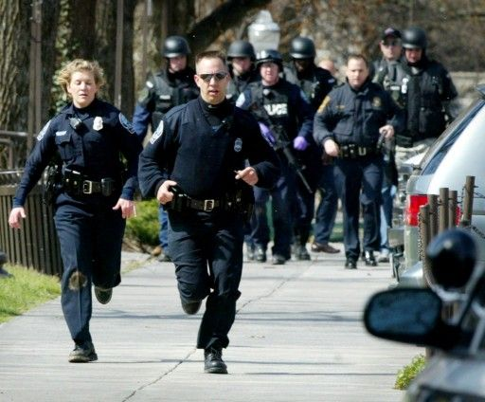
Courage
Is resistance to fear, mastery of fear & not absence of fear (Mark Twain)

Slide 98
Courage to Lead
Courage at the core of leadership
Distinguishes a great leader from an excellent manager
A mindset that enables the leader to face difficulty, pain, or danger w/out fear
Martin Luther King Jr.:
  “The ultimate measure of the leader is where he/she stands at times of challenges”
  “Courage is the power of the mind to overcome fear”
Winston Churchill:
  “Courage is what it takes to stand up & speak; also what it takes to sit down & listen”
Simon Sinek:
  “Courage of leadership is giving others the chance to succeed even though you bear the responsibility of getting things done”
  Giving credit where due

Slide 99
Role of Courage in Leadership
Gained through experience
Walk into the unknown
Builds influence through trust
Developed through relationships
  “Got your Six”
Builds collaboration & teamwork
Developed before the crisis
Take risks
Challenges the status quo
  Social architect
Confronting conflict
Doing what is ethical & not what is convenient
Make a decision & follow through
Hold others accountability
  Enforce policies
Delegate responsibility to others
Challenge yourself
Admit mistakes & handle criticism
Builds moral character & integrity
Inspires and challenge others
Creates an environment where people are at their natural best
Create a climate/culture to create peak performance

Slide 100
Building the Team
Ongoing process of sharing the vision and mission
Ongoing development/revising the goals and strategies
Leading your personnel through challenging times
Creating the culture w/ high expectations:
  Individual
  Team
  Winning mindset
  Dedication to execution
Result→ Championship Performance
Endeavor to:
  Maintain a positive mindset
  Grow→ Life long learning
  Influence & mentor others

Slide 101
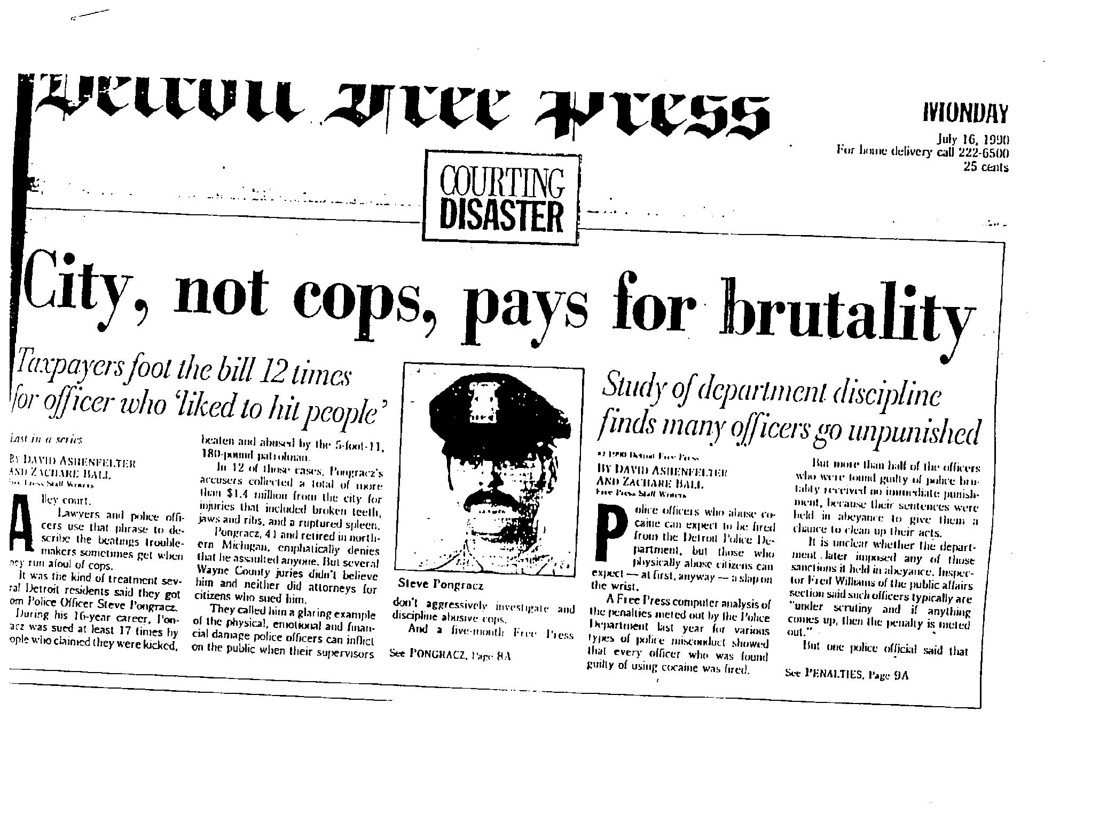
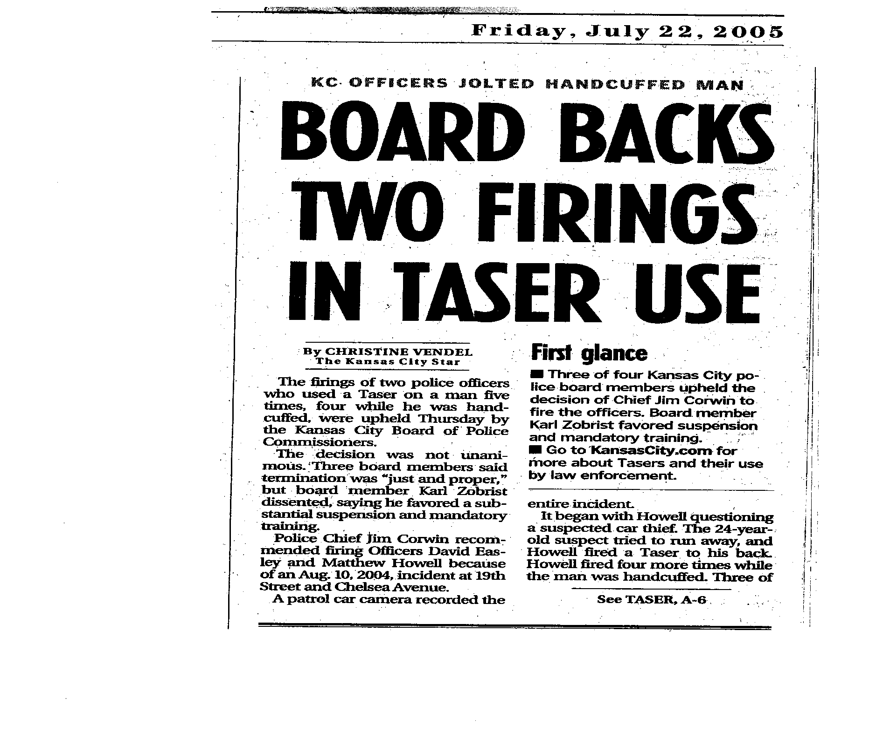
Employee Discipline & Discharge

Slide 102
Disciplinary Systems Issues
Source of frustration & conflict
Source of mistrust in community
Unfair & differential treatment [51%--treated fair]
“Good Ole Boy” system
Code of Silence
Inconsistent, arbitrary, & unpredictable
Avoid confrontation, ignore or tolerate
Predominately focused on punishment & not behavioral change
Targets “high profile” cases & political
Punishment decided prior to “full investigation”
Sends mixed messages
Actually LEOs desire a “fair, consistent, and equable system”

Slide 103
Common Reasons Employer Are Sued
Failure to communicate job expectations
  [55%--only hear from Sgt., when do something wrong]
Failure to give notice when employees are not meeting them
Lack of consistency
Retaliation
Failure in following agency policy
Failing to provide due process
Absence of an opportunity to defend
Insult dignity
Violate the law

Slide 104
Common Topics on Discipline
Due process
Constructive discharge
Wrongful discharge
Sexual harassment
Sick leave & attendance
Work performance
Misconduct & Ethics
ADA & disability
Violations of P/P’s & Regs.
Criminal Drug Testing
CUBO
Grooming Reg’s
Conditions of employment
Speech
Fitness for duty
Discrimination & disparate treatment
Retaliation
Hostile work environment
Whistleblowing
Privacy issues
Off-duty activity
Performance standards
Performance evaluations
Investigations
Excessive discipline

Slide 105
Effective Disciplinary System
How effective is your disciplinary system?
Reflective of:
  Effective leadership & communication
  Clear connection between mission, vision, values, & ethical standards
  Current job descriptions
  Written P/P’s & enforced
  Written rules of conduct
  Linked with performance standards, performance evaluations, & regular review
  Creating a positive culture & work environment
  Effective supervision
  Effective FTO
  Constitutional policing & corrections?

Slide 106
Job Descriptions
Status?
Defines & describes the core tasks & duties of a position
Linked to agency rules, regulations, & P/P
Foundation for job standards & promotion
Sets forth qualifications and skills required
Provides basis for recruiting/hiring
Linked to training & personnel development
Baseline for field performance
Basis for supervisory actions:
Performance evaluations & Recognition
Corrective Action
Discipline

Slide 107
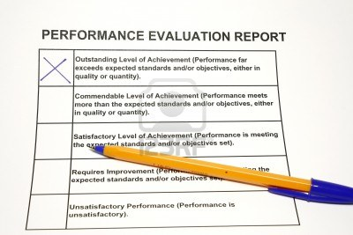
Personnel Evaluations
A systematic method of reinforcing agency standards
Agency standards?
Agency expectations?
Provides checking
Provides feedback
Provides coaching
Provides training
Provides remedial correction as needed
“Catch people doing things right”
Assists in defending claims of failure to supervise

Slide 108
Employee Wrongful Discharge
A common claim against administrators is a failure to discipline
Conversely, an employee may claim that the administrator terminated his/her employment unjustifiably
Public policy holds employers may not be terminated without due process
Employers may not discharge employee based on:
  Malice
  Bad faith
  Retaliation
  Discrimination
  Sexual orientation
  Race, color, religion, or national origin

Slide 109
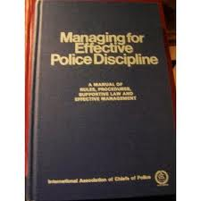
Wrongful Discharge
Such lawsuits emerge when an employee believes that he/she was discharged for no justification in violation of the 14th Amendment
Property interests or rights in employment are created by acts of employer to continued employment (Board of Regents v. Roth, ‘74)
  Must demonstrate a unilateral expectation of the job
Property Interests created in:
  Employee handbooks
  Policy manuals
  Contracts
  Other written documents

Slide 110
Wrongful Termination
Cleveland Brd. of Education v. Loudermill (1985)
  Property rights protected under 14th Amendment
  Property rights=rights in employment
  Employer shows a reasonable expectation of ongoing employment by binding policy that discharge for “just cause” → Property interests arise
  Applies to vested employees, completed probation
  May not terminate vested employees without due process
  Must provide a hearing & document, may have counsel, and may appeal
  Applies to employment & not a particular position
  Adhering to the requirement, defeats claims of wrongful discharge

Slide 111
Cleveland Brd. of Ed. v. Loudermill (‘85)
Central feature of due process
  Hearing
  Progressive discipline
  Protections ensure fundamental fairness
  Requires advanced notice in writing (24 hours)
  Charges provided in advance
  No right to counsel
  Investigation documents provided to employee
  Document the hearing & decision (in writing)

Slide 112
Employment @ Will in GA
1 of four states to retain the doctrine
Works @ will of the employer
No reason for termination
Protections come from Federal Law:
  May be able to grieve termination under grievance
  Acts of discrimination (race, sex, age, religion, natural origin, & disability)
  Job safety, wage & hour payments, employee benefits, FMLA, & FLSA
  Could file lawsuit

Slide 113
City of San Diego v. Roe (2004)
An officer made a video of himself taking off his clothes & engaging in a sexual act & sold on E-Bay
Discovered by supervisor & IA found conduct violated department policies
Chief gave order to stop, he refused, & chief fired him
Roe sued the chief claiming the firing violated 1st Amendment of right speech
District court granted SJ
Appellate court reversed, conduct protected & unrelated to work

Slide 114
City of San Diego v. Roe (2004)
S. Crt. reviewed & reversed ruling of 9th Circuit
Roe’s expression not qualify as a matter public concern as they did not inform public about the department’s operations or functions
However, his actions occurred off-duty, but his expressions were linked to his official status as an officer & designed to exploit his image as a City employee
Speech was not protected by 1st Amendment

Slide 115
Straub v. Proctor Hospital, 131 US __ [2011]
Straub a technician, in Army reserve, & supervisors hostile to his military duties
Given disciplinary for failing to perform work tasks & given corrective discipline
HR fired him & filed a grievance, Board upheld
Filed suit under Uniform Services Employment Reemployment Rights Act (1994) protects employment discrimination
7th Cir. overturned lower court’s finding in favor of Straub
S. Crt. → What level of supervisor conduct impacts employment?
  Acting w/in scope of employment duties & actions motivated by hostility, liability attaches
  When motivated by animus intended to cause adverse employment action & action proximate cause of ultimate employment action, employer liable
  Tort law requires showing intent & consequences of act

Slide 116
Bostock v. Clayton, Co. (‘20)
S. Crt. Consolidated 3 cases: Altitude Express, Inc. v Estate of Zarda, R.G. & G.R. & Harris Funeral Homes, Inc. v. Equal Employment Opportunity Commission
Employer in each case, fired long-term employee for being homosexual or transgender
Bostock: fired for conduct unbecoming for participating in a gay recreational softball league
Altitude: Zarda mentioned he was gay after hired
Harris: Stephens presented as male at hire and informed she planned to live and work as a woman
Each employee sued under Title VII alleging sexual discrimination
11th Circuit: upheld Clayton County’s termination—Title VII not prohibitory
2nd & 6th Circuits ruled in favor of employees

Slide 117
Bostock v. Clayton, Co. (‘20)
Title VII (1964): Unlawful for employer to fail or to refuse to hire or discharge or discriminate against a person based on race, sex, color, ethnicity, or national origin
Employers argue: intentional discrimination of employee based on being gay or transgender status not a basis for Title VII liability
S. Crt: Held an employer who fires an employee for being gay or transgender violates Tittle VII
Employer who intentionally discriminates against employees based on sex or transgender status engages in sex-based rules (policy) in violation of the law

Slide 118
Muldrow v. City of St. Louis, 601 U.S. __ (‘24)
Sgt. Muldrow claimed employer transferred her from one job to another because she was a woman
Claim, discrimination based on sex and challenged the transfer under Title VII
Transfer implicated “terms and condition” of her employment
Eighth Circuit Appellate Court affirmed lower court’s holding of SJ for the City
Muldrow appealed and SCOTUS granted certiorari

Slide 119
Case Decisions Tell Us?
Keep P/P & Rules current (avoid vagueness)
Train all employees in policy & expectations
Train all supervisors, follow policies, & enforce policies
Zero tolerance for employee misconduct
Enforce & follow P/P & Regs & Accountability
Avoid retaliation
Regularly review employee performance
Timely investigate complaints (Citizen & officer)
Pattern of failure to correct/discipline heightens liability
Use corrective actions & progressive discipline
Document; Document; Document; Document actions !

Slide 120
Discipline & Discharge Process
Policies
Train Supervisors & Officers
Analyze Problem
Investigation
Secure Evidence
Witness Statements
Examine Prior Discipline for Similar Actions
Review Employee’s Past Work Record
Employee Interview/Hearing
Determine Decision
Communicate Decision
DOCUMENT !!

Slide 121
Components of Standard Disciplinary Systems
Generally based on progressive discipline
Early Identification & Intervention system
Verbal warnings & reprimands
Written warnings & reprimands
CAP’s or PIP’s
Retraining
Investigations
Suspensions
Demotion
Termination

Slide 122
Strategies for Avoiding Wrongful Discharge (Risk Mgt.)
Employee handbooks
Written discipline policy
Written termination policy
Progressive discipline system
Train all supervisors & investigators
Candid & regular performance evaluations
Effective supervision
Documentation of remedial actions & discipline
Thoroughly investigate & document
Reasonable opportunity to meet expectations
Suspend during investigation, if feasible
2nd reviewer of discharge decisions
Document all complaints
Allow to resign
Document actions

Slide 123

Employee Assistance Programs
Health resources
Substance abuse
Psychological services
Work-Life consultation
Veteran Administration
Mediation programs

Slide 124
Corrective Action Plans/Performance Improvement Plans
State performance to be improved; be specific and cite examples,
State the level of work performance expectation and that it must be performed on a consistent basis,
Identify and specify the support and resources you will provide to assist the employee,
Specify the employee’s responsibility correcting behavior
Communicate your plan for providing feedback to the employee. Specify meeting times, with whom and how often.
Specify the measurements you will consider in evaluating progress,
Specify possible consequences if performance standards are not met, employee signature, & follow-up by sup.

Slide 125
Alternative Discipline Process
Peer Review
  A form of an early intervention
  Veteran officers review officer conduct or performance
  Complaints, use of force, verbal abuse, arrests, arrests, injuries, vehicle accidents
  Put conduct in perspective of the team, unit, shift, agency, community, & profession
  Considers the circumstances
  Recommend corrective action
  Peer influence to encourage and reinforce positive behavior

Slide 126
Early Identification & Intervention System
Is a process to identify early marginal employee performance
A supervisory alert for early intervention to correct performance/behaviors
A computer-based management tool responsive to employee work performance
Responds to performance indicators
Intercedes prior to major disciplinary process
Focus on work performance
Identification coupled with remedial actions
Maximizes organizational resources to assist employees
Enhances accountability and employee success
Underscores responsive supervision measures

Slide 127
EIIS--Performance Indicators
Citizen/detainee complaints
Citizen injuries from force
Abuse of sick leave
Reports BWC
Employee comments
Other supervisor feedback
Complaints from court
Arrests/Daily activities
Accidents
Vehicle collisions
Minor policy violations
Change in work habits
Field observations
Use of force incidents
Post-incident reviews
Failure to appear court
Internal affairs
Missed training
Instructor feedback
Radio communications
Use/misuse of technology
Use/misuse of equipment
Marginal performance
FTO evaluations
Performance evaluations
Awards & commendations
Recognition

Slide 128
EIIS--Intervention
As patterns develop, respond based on nature/severity of the issue
Follow agency policy and notify immediate supervisor
Possible intervention options:
  Policy review
  Coaching/Mentoring
  Referral HR, EAP
  Peer remediation
  Re-Training
  Chaplin
  CAP or PIP→ 90-180 days monitoring with immediate supervisor
  Re-assignment or Transfer
  Documentation

Slide 129
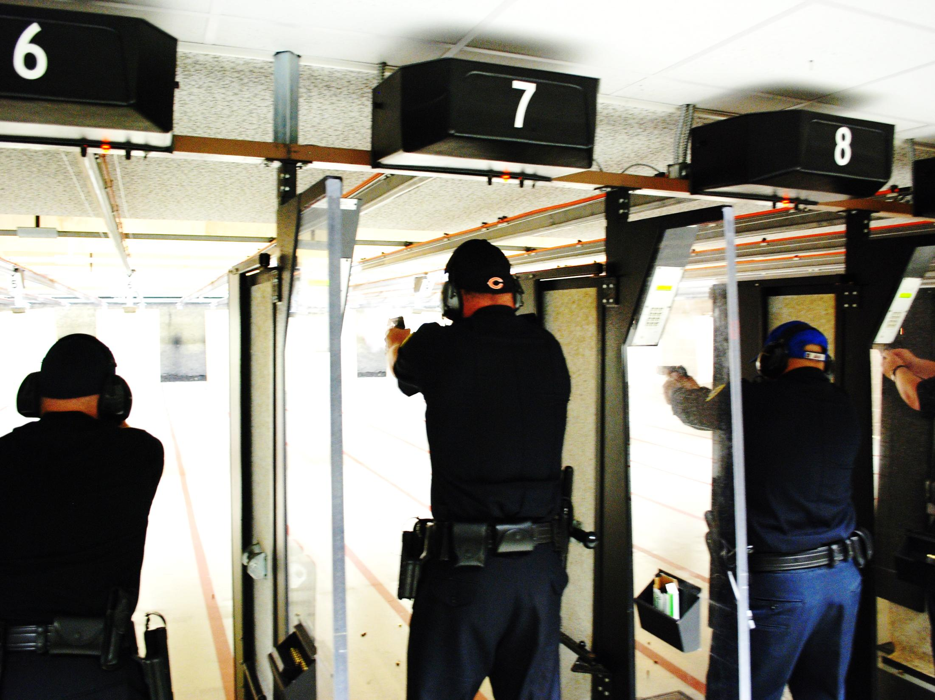
How are your LEOs trained?

Slide 130
SCOTUS—Training
Canton v. Harris (1989) & Connick v. Thompson (2011):
  Deliberate Indifference Standard
  Affirmative duty to train
  Linked to practice, policy, and custom of the agency→ choosing not to train
  Liability→ on notice of a pattern of constitutional violations linked to faulty training
  Must provide training on a regular basis (Issue of Frequency)
  Focus of training→ Commensurate to “recurring job tasks” of officers
  Focus of training→ Realistic training
  Training need only be adequate
  Single incident does not “generally support liability”

Slide 131
Failure to Train Questions
Deliberate or conscious choice not to train?
A causal connection between failure to train & constitutional rights violation?
Are there past incidents/pattern, which placed Chief on notice more training needed?
An obvious need for more or different training exist?
Lack of training linked to the CRV?; Training deficiency cause CRV?
Was training adequate to assigned tasks & provided on an ongoing basis?
  What does training record show?
Training prepare LEO to respond to varying circumstances?
Evidence demonstrate LEOs adequately trained?
LEO act within policy & training?
Did a failure to train amount to deliberate indifference?

Slide 132
Chief of Police
Deputy Chief
Deputy Chief
Planning
Night Command
Crime Analysis
Professional Standards
Public Affairs
Legal Services
IA
Inspections
Strategic Operations
Investigative Ops
Field Operations
Emergency Response Unit
Professional Development
Staff Services Command
Special Investigation
Criminal Investigation
Forensic Services
Patrol
Crime Intell
Psych Services
Jail
Homicide
Crime Lab
Traffic Enforcement
Auto Theft
Special Ops
Training
Records
Gang
Burglar Theft
Identification
Mental Health
Tactical Ops
Employee Services
Technology Services
Narcotics
Juvenile
Property
Emergency Comm/Mgt.
Vehicular Crime
Robbery
Canine Unit
Vice/Sp. Crimes

Slide 133
General Training Issues
What training is required/needed?
Job duties of the LEO?
Subject matter addressed?
  Specific or relevant to subject?
  Recurrent situations addressed?
Training meet state standards?
Manufactures guidelines?
Hours of training?
Record of documented training?
Field performance match agency policy & training→ Supervisor evaluate?
Constitutional violation?

Slide 134
Training Implications
Goal is realism in training:
  (Ratey,’01): Contextual conditioning-max learning
  Reality-based (City of Canton v. Harris, ‘89)
  Zuchel v. City & Co. of Denver, Co (1993) $330,000
How “REAL” is your training?
Unrealistic Training Leads to Unrealistic Performance!!
  Objective is to build officer expertise, keep them in the mode of training
Use of force training should present students with confrontation problems to solve
Scenario-based training
Assists in developing experience by giving “brain upgrades”

Slide 135
Competency-Based Training
Combination of training design & instructional methods to enhance:
  Knowledge; Comprehension; Skills; Proficiency; Application; & Assessment
How is LEO competency evidenced?
Officers competent in P/Ps?
Receive ongoing training annually?
Legal/Liability Updates?
Officers/supervisors current in training for their job assignment?
Competent on job tasks & skills?
Competent with force techniques, equipment, weapons, & restraints
Demonstrate comprehension of policy & training in the field?
Justifiable decision making
Realistic training

Slide 136
Managing The Training Unit
Training Policy/Plan: regular basis→ commensurate to recurring job tasks
  What is your training standard?
  Do field incident outcomes match policy & training provided?
Training supervisor/coordinator
Training needs assessment:
  Case law decisions: SCOTUS; Appellate Courts; State law
  State Legislation & State requirements
  Field observations by supervisor
  Audit records
  Review: reports, incidents, videos, investigations, complaints, & workman comp.
  Review LEO evaluations
  Interview LEOs
  Emerging areas/issues/trends
  Equipment needs
  High Liability & High Profile issues

Slide 137
Brown v. Chapman, 814 F. 3d 447 (6th Cir. 2016)
An officer used a CEW on a combative arrestee who later died
The family filed a § 1983 claim
The appellate court overturned summary judgment, opining:
  The use of force policy was the “moving force” violating the decedent’s rights
  The training of the officer was inadequate to the tasks the officer performed
  The inadequacy amounted to deliberate indifference
  The inadequacy was closely related to or actually caused the decedent’s injury
  Determined the inadequate training was direct causal link which violated the decedent’s right to be from excessive force

Slide 138
Harper v. McAndrews & Harrison County (‘20)
Sgt. McAndrews made welfare check at residence & observe McAfee attack sister; McAfee was mentally disabled; 60 yrs. old & used walker
Activate CEW, no effect, a struggle ensued, McAfee grabbed CEW & McAndrews shot firearm 2x, killing McAndrews→ feared he use & get gun
Estate filed § 1983 claims: EF; Medical care; & failure in policy & training
McAndrews testified: Back-up not necessary & he removed CEW cartridge
CEW only non-deadly force option provided by Sheriff, McAndrews completed 4 hrs. of CEW training in 6 years (2012), & limited knowledge of it’s capacities
Crt.→ use of deadly force was based on his lack of understanding of the CEW
No training and lack of policy on welfare checks
Crt.→ Excessive force & DI to policy and training

Slide 139
Managing The Training Unit
Policy
Instructor certification & re-certification
Academy
Rigorous FTO & Rigorous STO
Specific to department needs
Legal/Liability
Traffic enforcement
Arrests, Searches & Seizure, Traffic Stops, & Pursuits
Response to non-criminal calls
Medical/Mental Health intervention→ People in crisis
Use of Force

Slide 140
Managing The Training Unit
High profile/High liability
Qualification v. Training
Instructor certification/re-certification
Keep LEO current
  Officer; Supervisor; & Administration
  Special tactical operations
Testing
Training documentation & record keeping
  Computer system
Retention of all training curriculum:
  All training curriculum should correspond back to agency policy (s)
Annual report: Outcomes & assessment

Slide 141
Training Methods
Roll Call
Meetings
Computer-Based/Micro Lessons
Classroom
Case Studies
Incident Video Assessment
Skills Proficiency
Scenario-Based (Competency-Based)
Simulators
Simmunitions
Decision Making
Outside instructors/Outside Training Courses

Slide 142
Training Implications
  Use of multiple delivery methods and competency-based
  Employ safety protocols
  Documentation
  Competent in Response to Resistance policy
  Officers, Administrators, Instructors, and Investigators
  Training curriculum matches policy
  Competent in law and legal
  Competent in decision making and force justification
  Competent realistic training, comports with Canton v. Harris (89)
  Beyond classroom and range (“Range Conditioning”)
  Scenario-Reality-Based (single/multiple officer response)
  Simulators
  Simunition
  Low-Lighting, adverse environment, and night-time shooting

Slide 143
Training Implications
  Objectives:
    To enhance officer safety, confidence, and competence
    To build officer expertise
    To enhance perception formation
    To enhance decision-making and force justification
    To keep officers in the mode of training
    To provide “brain upgrades”
  Force training—focused on problem solving
  Outcome→ Superior Field Performance
Know What You Can Do, When You Can Do It, & Be Prepared To Act!! (Equation for Success)
Know the Law, Know Your Policy, & Know Your Tactics

Slide 144
Litigation Risk Mitigation Model---Supervisor Training
Policies & Procedures
Legal & Liability Issues
Role as Supervisor
Dynamics of Leadership
Leading Team/Team Building
Verbal & Written Skills
Technical v. Human aspects of job
Field Assessment/Review Reports
Coaching & Mentoring
Progressive Discipline
Ethics & Accountability
Sexual Assault/Misconduct
Critical Incident Management
Addressing the Media
Organizational Culture
Decision Making/Problem Solving
Persons in Crisis/Diminished capacity
Crowd Control
Managing Marginal Employees
Early Intervention System (EIS)
Use of Force
Investigations
OIS/Arrest-Related Deaths
Crime Analysis/Crime Mapping
Threat & Risk Management
Officer Safety & Wellness
Instructor Certifications
Scenario-Based Training
Documentation

Slide 145
Litigation Risk Mitigation Model—Officer Training
Department Policies
Laws of Arrest, Search & Seizure
Legal & Liability Issues of the Job
De-Escalation techniques
Subject Control Techniques
Force Weapons & Restraints
Firearms
Force Option Transitioning
First Responder
People in Crisis/Diminished Capacity
Substance Abuse
Medical Care & Mental Health
Interpersonal Skills
Report Writing
Decision Making/Problem Solving
Involuntary Commitments
Arrest-Related Deaths
Investigations
Crowd Control
Emergency Management
Critical Incident Management
Scenario-Based
Officer Safety & Wellness
Ethics & Accountability
Instructor Certifications
Preparing To Be a Supervisor
Test & Documentation

Slide 146
11th Circuit—Training Issues
Estate of Schultz v. Brd. of Regents of UGA (8/10/21): SJ granted
  DF case; No DI on failure to train claim
Favors v. City of Atlanta (2021): SJ denied
  Failed to train on DF at moving vehicles; City on notice & question for jury
Hunter v. City of Leeds (8/11/21)
  SJ denied on LEO DF; No deficiency in policy; training; or supervision
Helm v. Rainbow City, AL, 989 F.3d 1265 (2021): SJ denied
  Issues of: Failure to train on CEW; Failure to Supervise; & Failure of LEO to intervene
Perez v. City of Sweetwater, Duarte, et al., 770 Fed. Appx 967 (2019)
  No deficient policy; no failure to train; & no failure to investigate

Slide 147
11th Circuit-- Training Issues
Horn v. Barron (2018): SJ granted; LEO use takedown & result in injury
  Reasonable for knee on back to restrain & No failure to train
Quinlan v. City of Pensacola (2011): SJ granted for Chief who properly trained & supervised officers in performing traffic stops
Keith v. DeKalb Co. GA, 749F. 3d 1034 (2014)
  No failure to train & SJ awarded
Mercado v. City of Orlando (2005)
  LLF—Projectile—SJ Denied; No deficiency in policy, training or supervision
Gold v. City Miami (1998)
  SJ granted on force on cuffed arrestee
  SJ granted on policy, training, and supervision

Slide 148

LEO Safety, Health, & Wellness
Officer Safety &
Risk Management
Administrator creates & supports a culture of safety
Daily reminders the job of LEO is dangerous & exposed to
various risks
  High risk encounters; High stress situations; Assaults; & Health risks
  Recurring basis
Working with City/County HR & EAP
Promoting safety and health of LEOs is the right thing to do:
  Acquire, maintain, & require use of safety equipment; PPE; & other resources, equipment reasonably necessary to protect LEOs
  Functional physical fitness program (incentives)
  Functional stress management program
  Functional health care program
  Recurring training on proper use of equipment & measures to reduce associated risks
  Track & keep records of occupational accidents, assaults, illness, & injuries
  Prepare & submit an annual report

Slide 149
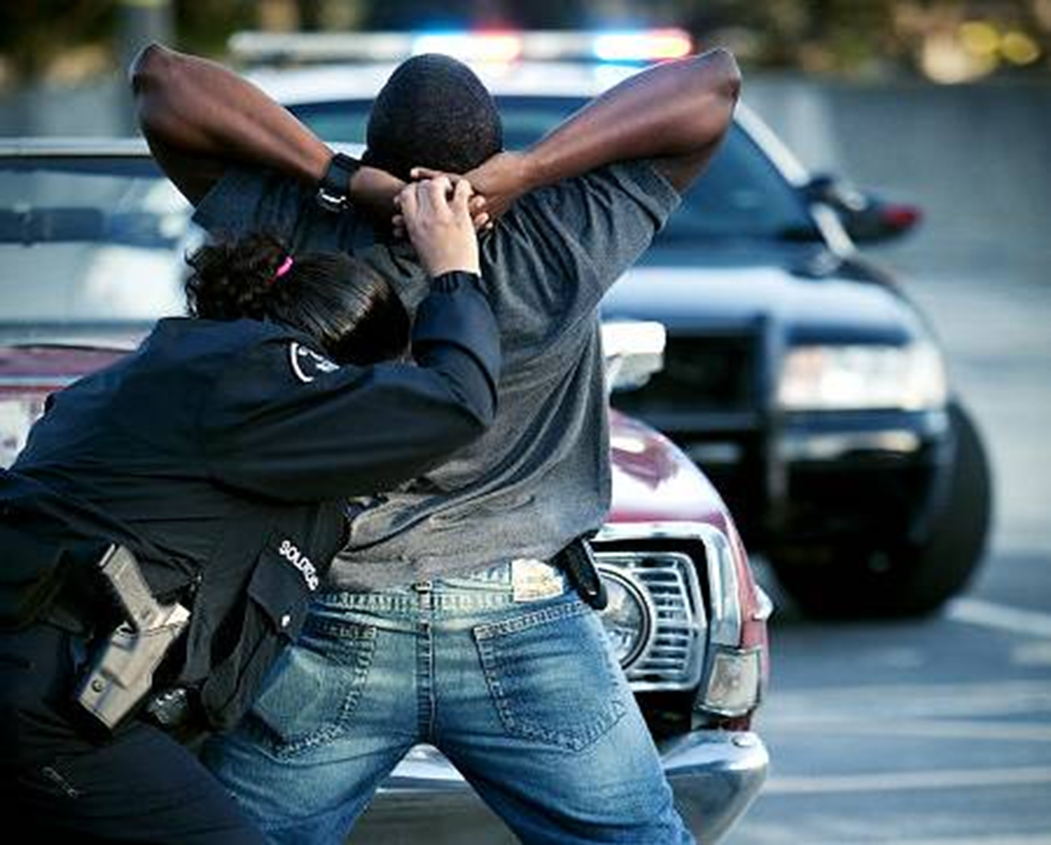
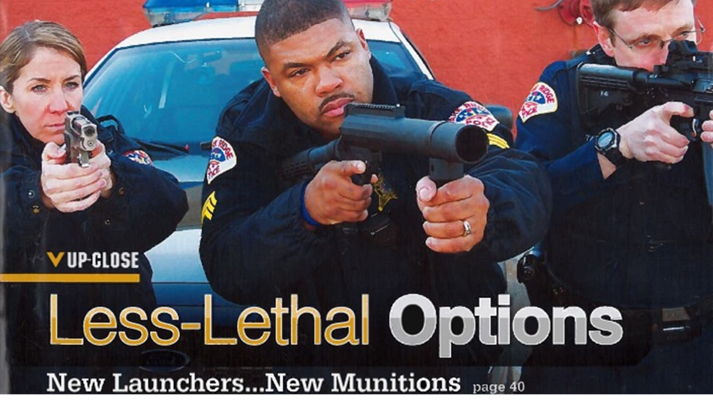
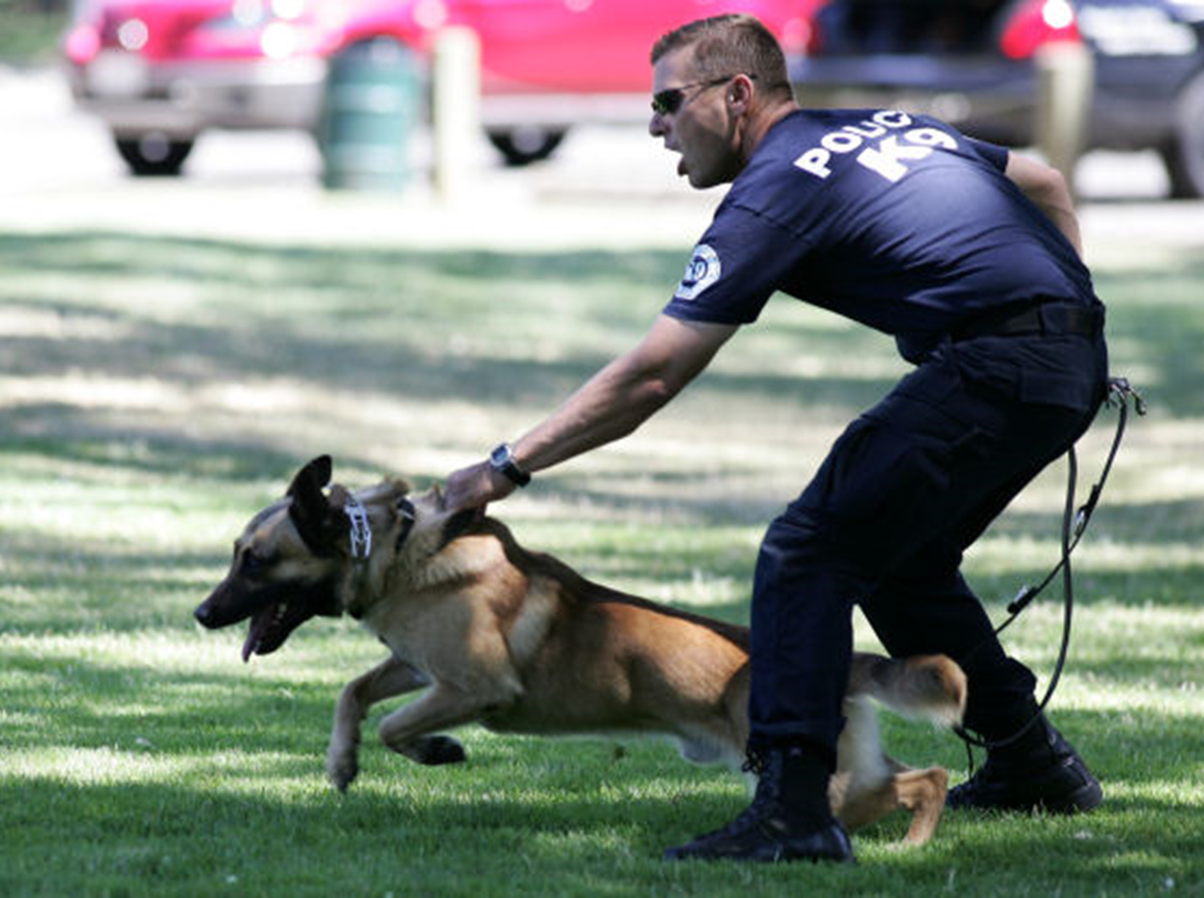
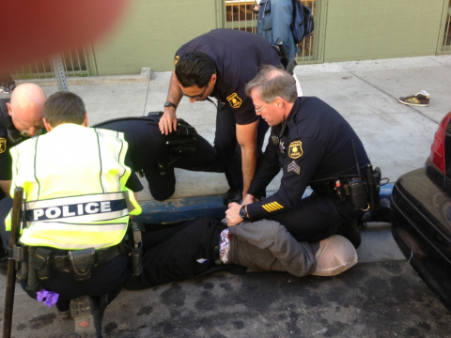
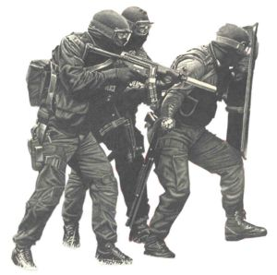
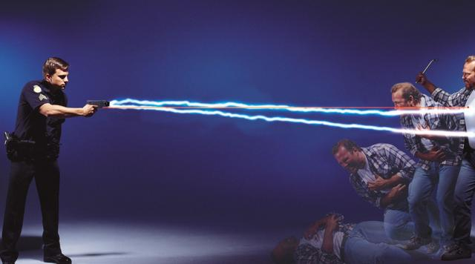
Liability & Use of Force

Slide 150
Selected 11th Circuit UoF Quotes
“LEO not required, in a tense & dangerous situation to wait until the moment a suspect uses a deadly weapon to act to stop the suspect” (Tillis v. Brown, ‘21)
“An LEO does not have to wait until a gun is pointed @ him before taking action”
  Harrell v. Decatur County, ‘95; Montoute v. Carr, ‘97
“The Constitution does not require a LEO or corrections officer to seek medical attention for every arrestee or inmate who appears to be affected by drugs or alcohol” (Barnette v. Taylor, ‘08)
“A LEO does not need case law to know that by intentionally shooting an arrestee in the head, resulting in brain trauma, violates the Constitution” (Mercado v. City of Orlando, ‘05)
“We have recognized that a TASER is generally not deadly force (Fils v. City of Aventura, ‘11)
“Dept. policy or training on CEW, does not guide court analysis” (Boyton v. City of Tallahassee, ‘16)
“A plaintiff must prove a policy, custom or practice caused the alleged deprivation”
  Hoefling v. City of Miami, (‘16)

Slide 151
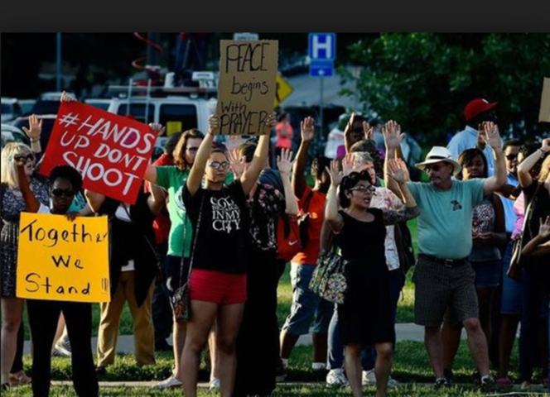

Public’s Perspective on Police Use of Force
Officers in untenable position
Should use least amount of force
Should use least injurious force option
Should be more patient and understanding
Should be tolerant of people acting out
  Being attacked, injured, spit on, risks of the job
  Are intolerant heavy handed jack-booted thugs
  Should almost never use force
Should know difference between person who:
  Is an intentional immediate threat of harm
  Is fleeing from (serious physical harm) offense
  Needs medical or mental health crisis assistance
  (rather than committing crimes)

Slide 152
Judiciary Analysis/Perspectives
Graham v. Connor (1989) decision, deference to LEO
But, also understand that “some judges” will interpret facts of case through their eyes, not yours
Unless video, law requires judges to view case from “plaintiff’s perspective”
Judges use additional factors beyond Graham:
  Assess “pre-incident/force factors”
  Assess “other options” available to officer
  Consider suspect condition
  Use varying definitions of active resistance
  Assess the outcome of the use of force
  Additional assessment factors
Must be aware how courts apply Graham criteria & other factors

Slide 153
Use of Force Litigation Trends: 2006-2023
Force resulting in serious bodily injury or death:
  NF TO-AD
  Firearms/OIS
No systematic collection of litigation payouts or case settlements
Pre Ferguson: 2006 to 2014 (n= 587 cases)
  Average settlement = $4.1 million
Post Ferguson: 2015 to 2023 (n=519 cases) N=1,106 cases
  Average settlement = $19 million → 5 times or 79%
  Cox v. City of New Haven, CT (No. 3:22-cv-0129, 6/14/23)→ $45 million settlement
NY, LA, Chicago, Philadelphia, Prince Co., Baltimore, Detroit, Cleveland, Milwaukee, Minneapolis, and Phoenix= 74%
(Alexander, et al, ‘22; Marshal Inst., 2023; Ouss and Rappaport, ‘20; Ross, ‘23; Schwartz, ‘14)

Slide 154
What We Know About LEOs Use of Force
Respond/Assess a dynamic situation in varying circumstances/environments
Expected to be accurate 100% despite human factors limitations, life threatening circumstances, & split-second decision-making
UoF Rare in Occurrence (‘96 -‘22)→ Annual Averages Estimates:
  Over 150 million CFS, Self-Initiated, & Other Police Public Contacts (PPC) [BJS: 20; NENA, 20; CDC; 20; Johnson, 16]
  Non-deadly force used/threatened in about 1/54 PPC (1.8%) [No Deaths]
  About 13 mil arrests; UoF in 1:110 criminal arrests (1990-2019; Duffin, ‘20)
  About 1,000 OIS= 0.0003% PPC & 0.008% during arrest [2015 to 2020; WA Post]
    OIS→ About 1/1,041,737 CFS
  About 1 Subject Prone/100 criminal arrest [No Deaths]
  About 900 ARD (Non-Firearm)→ 1:2.6 mil/PPC
  About 1:CEW application/3,000 PPC/CFS
  About 1:3,000,000 CEW ARDs (Non-Firearm)

Slide 155
Exercising Leadership
Managing use of force presents challenges requiring:
  Analysis; Reporting; Decision-Making; Planning; Directing; Organizing; Staffing; & Leading
Managing the challenges present opportunities to exercise leadership
Use of force incidents are rare yet can be high profile & high liability
Incident frequently triggers:
  Emerging questions
  Investigations (Internal & External)
  Protests, disturbances, & riots
  Potential criminal prosecution
  Discipline and/or termination
  Review of policies, protocols, training, tactics, & field operations
  Exposure to civil liability

Slide 156
Emerging Issues Examples
GA Supreme Court: A TASER may be a “Deadly Weapon” (Eberhart v. St. GA, S19A0803, 10/31/19): Eberhart—Life-Felony Murder & Weems—5 years
  Violation of SOP & training
11th Circuit→ “TASER is generally not deadly force” (Fils v. City of Aventura, ‘11)
Prosecutor to Grand Jury/Jury: “15 deployments of a TASER, with 50,000V=750,000V” (GA v. Copeland; ‘17, ‘19, ‘21)
LEOs in Deposition (2019):
  “Yes, the TASER delivers 50,000 V on each trigger pull”
  Plaintiff’s attorney: “So you delivered 100,000V into my client, right? Yes.”
Harper v. Andrews & Harrison County, WL 6545134 (U.S.D. Crt. E.D. TX, ‘20):
  Sgt. Andrew’s use of deadly force was based on his lack of understanding of the TASER
  Sheriff deliberately indifferent for failing to train

Slide 157

Use of Force Competency
Are LEOs competent in their legal responsibility when using force?
Are all LEOs, supervisors & investigators competent in:
  Department force policy & procedures?
  Application of de-escalation strategies?
  All subject control techniques?
  All authorized equipment & all authorized restraints?
  All authorized firearms?
  Force decision-making?
  Manufacture’s specifications?
  How is competency demonstrated/measured?
How would you describe you agency’s Culture of Use of Force?
Do officers submit detailed reports justifying their use of force?
Do you routinely review officers reports? BWC? Debrief?
Use a force incident as coaching opportunity?

Slide 158
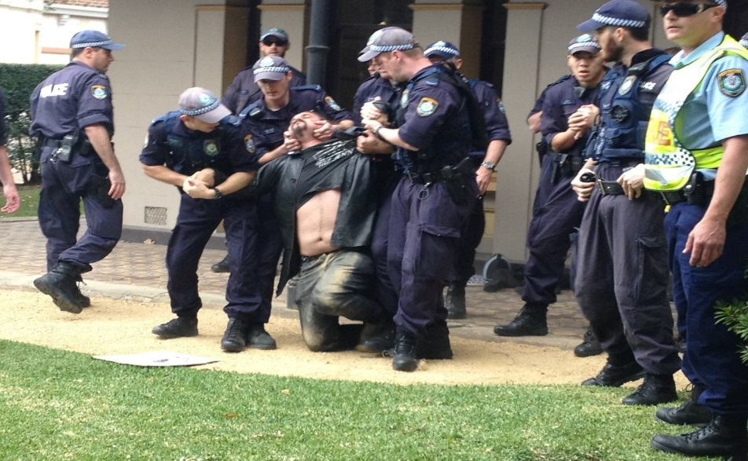

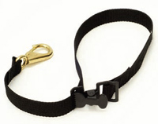
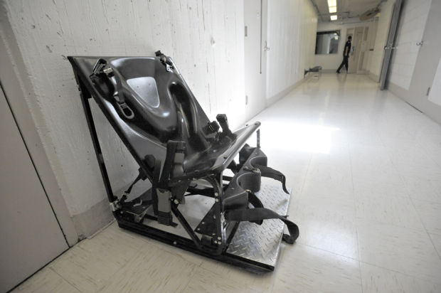
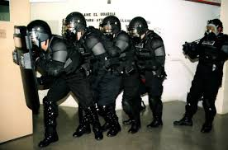
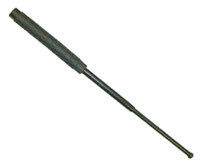
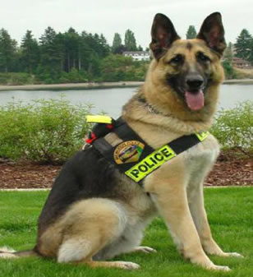
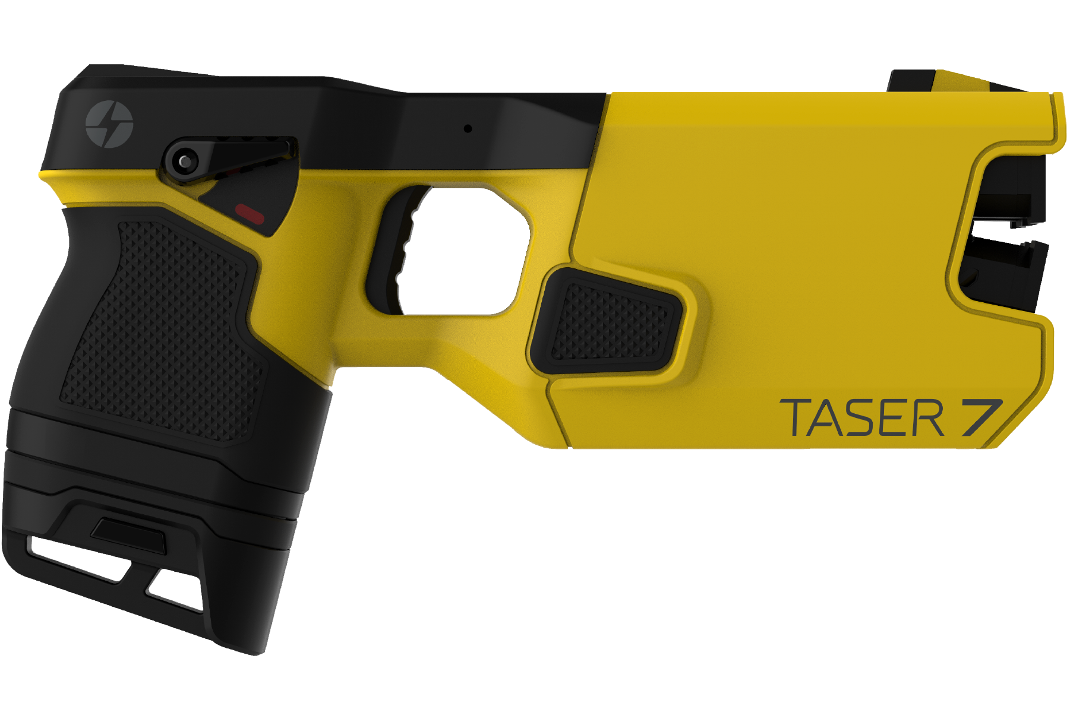
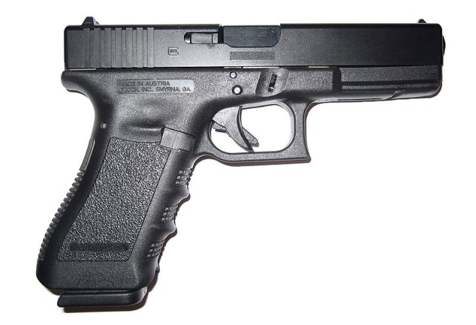
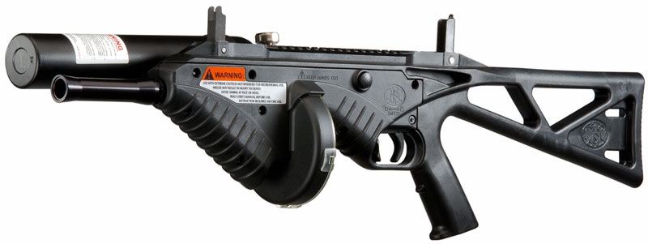

Slide 159
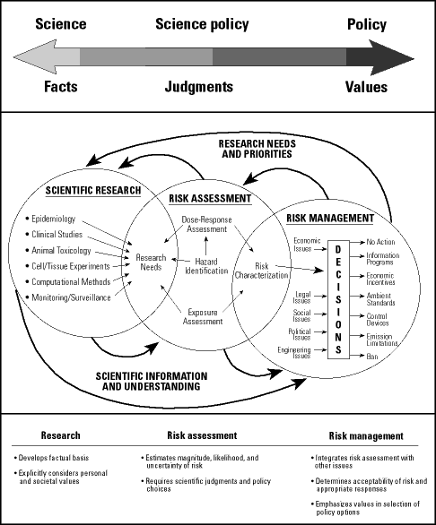
Assessing the Science of Force Techniques, Technology, & Tools
Assessed against the published & reputable science?:
  EHC techniques
  Aerosols
  Impact weapon
  CEW
  Projectiles
  Restraints & Prone restraint
  Canine
  Spit Shield
  Deadly force
Has it informed?:
  Policy
  Training
  Field implementation & monitoring by supervisors
  Field assessment
  Data collection and Reporting
Legal
Medical
Tactical

Slide 160
Summary of Human Studies and CEW (5/23)
Years | Subject | Number of Studies
2006-2021 | Human Cardiac, Prospective Studies | 75
2004-2021 | Risk Cardiac Arrhythmia, VF, or heart disturbance | 80
2003-2020 | Risk due to chemical substances | 40
2003-2021 | Risk of respiratory distress | 25
2003-2019 | Reduction in the Use of Deadly Force | 62
2006 -2019 | Reduction in Suspect Injuries | 45
2005- 2020 | Reduction in Officer Injuries | 33
2008-2019 | Less Injury than Using Physical Force | 40
2008-2019 | Used on ExD Subjects, not linked to SD | 9 (N=411)

Slide 161
Science & Restraint Asphyxia Research (‘88-’23)
Study (N=28) Number
Ventilatory Function (Reay, et al. ‘88) [*Price v. Co. of San Diego, ’97] 1
Exercise, prone restraint and ventilatory function 6
Exercise, prone restraint, hobble and hogtied & cardiovascular 4
Exercise, OC, Resp. Function & Restrained Position 2
Exercise, ventilation & Restraint Chair 2
Exercise, weight on back, prone restraint, hobble, & hogtie 7
Exercise, prone restraint, CEW applications & ventilation 1
Exercise, obesity, prone restraint, ventilation, weight on back 2
Prone restraint, knee/double knee & weight on back 1
Thoracic condition modeling (Flail chest) 1

Slide 162
Prone Restraint/Mortality Field Study #s
Year | Lead Author | Contacts/CFS | Arrests | Restrained Prone | Deaths From Prone
2012 | Hall | 1,566,908 | ---- | 537 | 0
2015 | Hall | 3,250,000 | ---- | 2,000 | 0
2016 | Ross | 876,503 | 110,173 | 1,085 | 0
2017 | Lasoff | 524,427 | ---- | 1,535 | 0
Totals |  | 4,650,930 |  | 5,157 (0.001) | 0

Slide 163
Tennessee v. Garner, 471 U.S. 1 (1985)
Police must make impossible split-second evaluations of unknown facts; and make difficult judgments by police in equally uncertain circumstances”
Standard (fleeing felon):
  Suspect must threaten the officer
  Probable cause that suspect has committed a crime involving the infliction or threatened serious harm
  Necessary to prevent suspect’s escape
  Give a warning if feasible

Slide 164
Graham v. Connor, 490 U.S. 396 (1989)
Objective reasonableness under the Fourth Amendment
Established 4 criteria of review:
  Suspect posed an immediate threat to the safety of officers or others
  Suspect actively resist arrest,
  Severity of crime at issue, and
  Suspect attempted to evade arrest by flight (Dangerousness)

Slide 165
Force Analysis: Graham Factors
Judged from the “Perception” of the officer; “Eyes of Officer,” “POV”
  Rapidly evolving, tense & dynamics of the Circumstances (ToC)
  Operating Environment & situational variables
  Type of Resistance demonstrated by the subject
  Take into account Split-Second Decision-Making
Court endorses “reasonableness at the moment” force was needed
Subject dictates the degree of reasonable force
Not required to consider “all force options”
Officers need not be correct → only reasonable (Plakas v. Drinski, 7th Cir. 1994)
Appellate courts assess additional factors

Slide 166
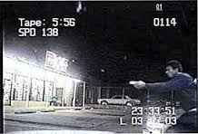
Totality of Circumstances Variables
Number of suspects
Size, condition, and age of suspect
Condition of subject
Pre-attack factors
Availability of weapons
Reaction time and time pressures
Duration of action
Violent history of suspect
Bystanders
Environmental conditions
Injury & exhaustion of officer
Exigent circumstances
Special knowledge

Slide 167
SCOTUS 4th Amendment Force Decisions
Tennessee v Garner (‘85 & DF)
Graham v Connor “ORF”(‘89 & EHC)
Saucier v Katz (‘04 & EHC)→ QI case
Brosseau v. Haugen (‘04 & DF)
Scott v Harris (‘07 & DF)
Plumhoff v Rickard (‘14 & DF)
Tolan v Cotton (‘14 & DF) → QI case
City & Co.of San Francisco v Sheehan (‘15 & DF)
Mullenix v Luna (‘15 & DF)
White v. Pauly (‘17 & DF)
Co. of Los Angeles v. Mendez (‘17 & DF)
Kisela v. Hughes (‘18 & DF)→QI case (MI w/Knife)
Torres v. Madrid (’21 & DF) Seizure defined
City of Tahlequah v. Bond (‘21, DF & QI)
Rivas-Villegas v. Cortesluna (‘21, LLF & QI)

Slide 168
SCOTUS 14th Use of Force 8th Amendments
Kingsley v. Hendricks (2015)
Graham factors, plus
Lombardo v. City of St. Louis, MO (2021)
Need to use force & Relationship between need & degree of force used
Efforts to temper the use of force
Severity of the security issue
Extent of detainee injury
Officer Perception of threat (POV: Associated human factors)
Rapidly, evolving, tense situation & Split-second decision making
Totality of circumstances
Merits of the facts of each case
Whitley v. Albers (1985)
Hudson v. McMillian (2004)
Hope v. Pelzer (2002)
Wilkins v. Gaddy (2010)
Cruel & unusual punishment
Sadistic and maliciousness
Purpose of causing harm

Slide 169
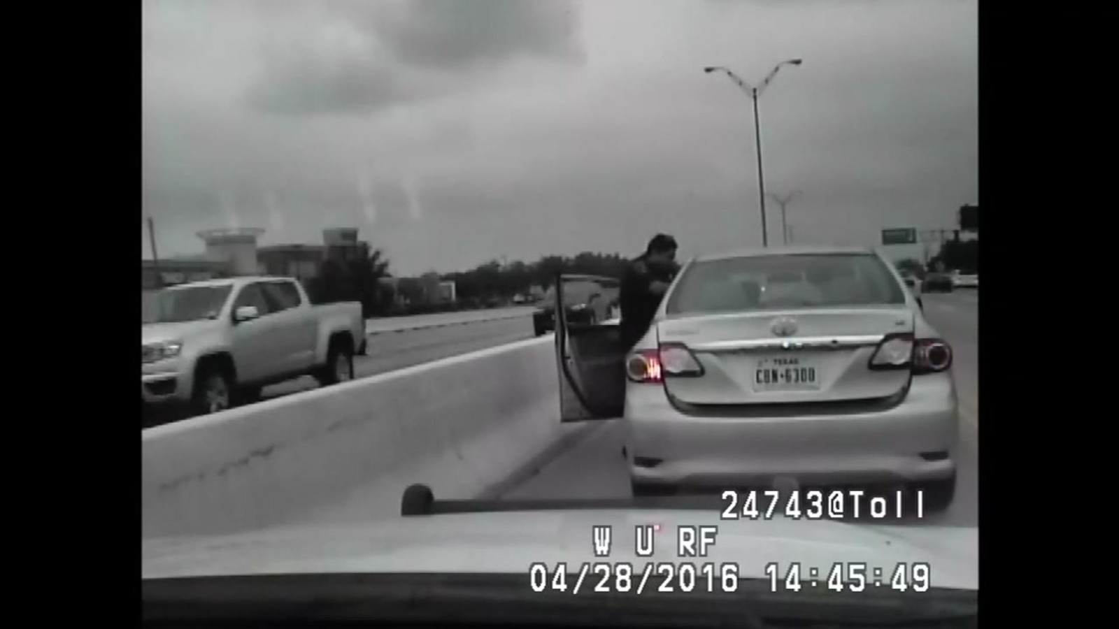
Barnes v. Felix, 2024 WL 2728079
SCOTUS—granted certiorari; October 4, 2024
Question at issue: Whether courts should apply the moment of threat doctrine to claims of excessive force? → Fourth Amendment
Federal Circuits not in agreement
  2nd, 4th, 5th & 8th → Moment of Threat Doctrine
  1st, 3rd, 6th, 7th, 9th, 10th , 11th & D.C.;
  T of C & officer’s actions leading to the incident
https://www.youtube.com/watch?v=9gbM_22fUbY

Slide 170
11th Circuit Court Use of Force Analysis
View facts in light most favorable to Plaintiff
    Anderson v. Liberty Lobby, Inc. (‘86)
    Traylor v. P’ship Title Co. (‘12)
Scope of authority/duties/lawful objective [Maddox v. Stephens, ‘17]
  Probable cause to arrest?
  3 Tiers contact: Consensual; RS; & PC [Jones v. State, (2012)—GA case]
  Officer initiative, Respond to dispatch, or Respond as back-up?
  Nature of circumstances?
Graham factors—but not comprehensive or exhaustive
  Objective Reasonableness
  LEO’s perspective→ crucial to analysis & only perspective which counts
  Reasonable LEO on scene at the time events unfolded→(Jean-Baptiste v. Gutierrez, ‘10)
  Tillis v. Brown (‘21): DF reasonable when vehicle used as weapon
  Buckley v. Haddock (‘08): CEW, intermediate force reasonable on resisting, cuffed subject; “4th Amendment does not require least intrusive alternative; nor is an officer required to wait for back-up”

Slide 171
Use of Force Constitutional Standards Timeline (M. Brave; ‘21)
<---------------------------- Serious Medical Care Needs-------------------------------------->
Lombardo v. City of St. Louis (‘21): Force objectively unreasonable based on the facts/circumstances?

Slide 172
11th Circuit Court Use of Force Analysis
4. Secondary factors [Lee v. Ferrao, ‘02; Patel v. City of Madison, ‘20]:
  Active resistance & LEO perception of threat
  Need for the application of force
  Relationship between need and amount used (Proportionality; Quantum of force; Magnitude of force) Oliver v. Fiorino (‘09): Grossly disproportionate force
  Efforts to temper force
  Severity/extent of Injury to suspect, but alone, does not equal unreasonable force
  Suspect has not given up or stopped resisting, not necessarily excessive
  Force excessive when applied after suspect is safely in custody (Galvez v. Bruce, ‘08)
  More serious offense, higher level of force---Vinyard v. Wilson (‘02)
Mobley v Palm Beach County (‘15) CEW & SJ:
  Right to make arrest→ Right to use some degree of force
  Typical arrest involves some force injury
  Severe injury alone does not make unreasonable
  Pivot Point: “Severe force after suspect safely in custody (cuffs) is excessive but force applied while suspect still resisting, posing danger to officers, even if force severe, not necessarily excessive”

Slide 173
11th Circuit Court Use of Force Analysis
5. Secondary Factors—Deadly Force
  Probable cause subject posed a threat
  Committed a crime involved threat of infliction of harm
  LEO provide warning if feasible [Bradley v. Benton, ‘21; Cantu v. City of Dothan, Al, ‘20]
  Time & Opportunity
  Level of reasonable force may change during the encounter (Hunter v. Cty. of Leeds, 11th Cir. ‘19)
6. Severity of crime? Committing a crime?
  Felony v Misdemeanor (non-violent misdemeanant)
  Dangerous criminal v. Diminished capacity (May use force for psychological eval)
  Hill v. Miracle (6th Cir. ‘17): 3 Factor Analysis:
    A threat or medical emergency?
    Force required?
    Force used reasonable?
7. Nature of subject resistance→ resistance v. non-resistance
  Danger to officer, others, & risk of flight by suspect (Weapons)
  Posed a threat/Immediacy of threat [Aggression, attack, charge, violent]
  Behaviors, actions, & statements/no statements of subject

Slide 174
11th Circuit Decisions: No Crime/Medical Issue
Oliver v. Fiorino (2009): SJ denied—no crime
Hoyt v. Cooks (2012): SJ granted—CEW applied
  Not initially but during intervention, assaulted LEO
Bussey-Morice v. Gomez (2014): SJ granted
Callwood v. Jones (2018): SJ granted
Nelson v. Lott (2018): SJ granted
Cantu v. City of Dothan, AL (2020): SJ denied; no threat/crime
Helm v. Rainbow City, Al (2021): SJ denied; no threat/crime

Slide 175
11th Circuit Court Use of Force Analysis
8. Officer observations, perception, & force option response
  Instructions and warning given
  Quantum of force (amount?); Proportionate to need; Force objective
  Force used after the need ceased?
  T of C →Examine facts known to the officer @ time
  Justification of each application of force
  Conduct lawful
  Failed to intervene
9. Medical Issue (s)? [Deliberate Indifference?]
  When recognize medical/mental health of subject
  When recognize medical emergency
  When call for supervisor
  When call for EMS
  Monitor subject after restraint
  Sustained injury/severity of injury
  Initiate first aid & Initiate access to medical
  Transport
  Delay or deny access to medical treatment

Slide 176
11th Circuit Court Force Analysis
10. Unreasonable Force
“LEO cannot use force, that is wholly unnecessary to any legitimate law enforcement purpose” (Lee v. Ferrao, ‘02; Mercado v. City of Orlando, ‘05)
No serious crime at issue
Generally, CEW excessive if used on passive resister
Subject did not present an immediate threat
Instructions or warnings not provided
Force disproportionate to the resistance
  Quantum/Magnitude of Force→ given the circumstances
Constitutional to use force to seize, but methods may be unreasonable
Failed to give subject time to comply
Need for force was unjustified→ Force created a substantial risk of harm/death
Multiple officers on scene
Once subject is controlled and restrained resistance has ceased—need stopped
Failed to intervene

Slide 177
Use of Force Analysis: NJ (2019)
Capps v. Dixon (2024 WL 340842; 1/30/24)
  Pled guilty to AA, 3rd, Lifetime ban and denied QI on excessive force claim
  Report showed, 3rd highest in NJ and #1 in dept., 81 reports/82 arrestees
  3.5 years as LEO; 8 citizen complaints and lied on reports
  Court acknowledged assess circumstances of force
  Plaintiff also alleged failures in: training, supervision, intervention, monitoring, investigations, remediation, and discipline
Force analysis/report of 468 PDs and the NJ State Police
Examined 43,629 use of force incidents: 2012 to 2016
10% of LEOs accounted for 38% of the incidents

Slide 178
Expert Analysis: Capps v. Dixon
Use of force reports
Citizen complaints
Moniker: “Glass Hands”
NJ force data report compared to dept. data → Issues of race
Force, averaged every 28 days
Review of BWC videos/reports
Investigations and outcomes
High number exonerated and IA kept DA at arm’s length
Supervisor practices not fully followed per policy
No evidence supervisor reviewed reports or BWC nor
Followed up on recommendations
No evidence supervisor monitored Dixon
Methodology: Reliable/Relevant?
Pattern emerge? Support claims?
Chief/supervisors on notice?
Deliberately indifferent?
Consider also, prior litigation and outcome from LEO’s actions

Slide 179
Failure to Intervene Elements
Plaintiff bears the burden to prove
LEO knew a person’s Constitutional rights were being violated
LEO had a realistic opportunity to intervene
Merely being on scene, insufficient
LEO chose not to intervene
LEO failed to take reasonable steps to prevent the harm
LEO’s failure to act caused the subject to suffer harm
Failure by a supervisor?
Courts examine facts and circumstances of each case and the totality of circumstances the LEO faced

Slide 180
Failed to Intervene: Risk Management Assessment
Law Enforcement Incidents
High risk tasks
High risk traffic stops
End of a pursuit w/multiple LEOs
Tactical/Specialized units
Protests/Crowd management
Active shooter incidents
Response to diminished capacity
Issues of “Contempt of Cop”
Detention Facility Incidents
Cell extraction/Insertion
Booking combative detainee
Supervision of special mgt. detainee → Retaliation
Facility disturbance
Escape/Attempted escape
Retaliation for filing grievance or lawsuit
Escorting detainees

Slide 181
11th Circuit Decisions—Duty to Intervene → CEL
Failed to intervene: SJ denied
  Must be in a position to intervene & LEO conduct outside the Constitution
  Fundiller v. City of Cooper City (1985): K-9 excessive
  Byrd v. Clark (1986)
  Priester v. City of Rivera Beach (2000): 14 K-9 bites excessive
  Velazquez v. City of Hialeah (2007)
  Trammell v. Thomason (2009)
  Keating v. City of Miami (2010)
  Salvato v. Miley (2015): DF; $2.5 mil; no immediate threat; Unarmed; No warning; Quantum of Force disproportionate & reasonable for FDLE to investigate shooting
  Helm v. Rainbow City, AL (2021)
No Failure to intervene: SJ granted
  Riley v. Newton (1996)
  McCullough v. Antolini (2009)
  Callwood v. Phenix (2016)
  Nelson v. Lott (2018)
  Callwood v. Jones (2018)

Slide 182
Force Decision Making Factors
Graham criteria and test of ORF
Call/Circumstance
  Specific articulable facts
  Crime v non-criminal activity
  Severity of crime
  Context of incident (TOC)
Operating Environment
Subject Behaviors
  Non-Compliant and statements
  Non-Violent physical resistance
  Body dynamics/Language/Posturing
  Actively resisting seizure/arrest
  Erratic--unpredictable behaviors
  Actively avoiding capture—Flee from LEO
  Active aggression
  Threaten officer or others
  Condition of subject
  Diminished capacity/Mind-body disconnect
  Escalation/ De-escalation of behaviors/resistance
  Furtive movements
  Actions/inactions guide response
Risk Threat Assessment
  Subject creates the risk
  Contextual cues of subject (pre-attack indicators)
  Subject variables
  Subject statements or no statements—verbal threats
  Distance and Positioning of subject
  Number of subjects and threat risk posed
  Minimal physical resistance risk
  Actions presented a safety risk
  Property damage
  Immediacy of threat--direct threat
  Serious risk of immediate danger
  Threat to self, officer, and others
  Danger posed by subject
  Dangerousness/Risk of flight
  Position of LEO or others
  Others harmed/Potential for harm
  Weapon or Access to weapon(s)
  Dynamics of the threat
  Exigent circumstances
  Risk and Gravity of Threat

Slide 183
Force Decision Making Factors
Officer Perception
  Operating information
  Expectation and Anticipation
  Situational awareness
  On scene knowledge
  Prior knowledge of subject
  Facts known to officer @ time
  Subject behaviors & Resistance
  Split-second decision making
  Rapidly evolving tense situation
  Limited time to assess situation
  Limited time for cognitive process
  Limited time to respond [Response x]
  Perceptional distortions
  Emotions
  Idiosyncratic prior experiences
  Inferences drawn
  Probable cause to believe
  Could rightfully believe
Officer Response
  Objective of officer response
  Call back-up; EMS; and Supervisor
  De-escalation techniques
  Verbal instructions; warnings, or advisements
  Time for subject to respond or recover
  Force options, tactics and Force justification
  Capture, control and restrain quickly
  Modulation of force
  Greater degree of resistance or threat—> elevate force measure
  Cease force when threat contained—subject complied and restrained
  Motorola Memory (‘Olinn)
  Observe and Monitor vitals of subject
  First-Aid and Access to medical care
  EMS transport
  Report
  Need to use force/force justification

Slide 184
Potential Force Policy Issues
Not including State and Federal standards of force
  “Objective “Reasonableness” (Graham v. Connor, 1989 & Kingsley v. Hendrickson, 2015)
Failing to include Graham or Kingsley language/criteria:
  LEO Perception; Split-second decision making; Reaction Time→ rapid/tense situations
Not including variables impacting Totality of Circumstances
  Failing to consider exigent circumstances of an incident
Improper Force Policy Standard
  “Officers will only use that force which is minimal to effect control of non-compliant subject”
Impractical and Dangerous Requirement (set up officer for failure/safety issue)
  “Officers must exhaust every means of non-lethal force, prior to utilizing deadly force”
Improper Classification/Definition
  “The ASP Baton is an intermediate level of force on same level w/OC spray and the use of Deadly Force”

Slide 185
Potential Force Policy Issues
Failing to address:
  De-escalation techniques & Time as a Tactic
  Force modulation & to cease force once resistance ceases
  Vehicle Related Tactics
  Improvised Weapons
  Requirement of Duty to Intervene
  All authorized techniques; restraints; equipment; & weapons
  Monitoring for subject injuries & access to medical attention
  Reporting requirements
Policy more restrictive than law v. “Use that amount of force the law allows”
Not keeping policy current
LEOs, Supervisors, & Chief not on same page
Failing to train and document training
Supervision responsibilities & activation of FIT review
No statement on consequences for violation
If sued tomorrow would your policy withstand a plaintiff’s claim for failing to direct, train, and supervise LEOs?

Slide 186
General Components: Response to Resistance Policy
Purpose and Goal
Statutory and Constitutional authority
Graham or Kingsley standard and criteria
Force definitions, justification & prohibited
Confrontation variables/TOC
Types of subject resistance
Use of verbal commands
De-Escalation Techniques—Time as Tactic
Authorized Techniques & Equipment:
  Empty-Hand Control Techniques
  Restraints (HC; Hobble; Flex Cuffs; Restraint Chair; & Bola Wrap)
  Less-Lethal Weapons (CEW, OC, IW, & Projectiles)
  Spit Shield
Canine
Use of Deadly Force
Improvised techniques or weapons
Patrol vehicle as force
Crowd control
Force on injured subjects w/disability
Special populations—diminished capacity
Duty to intervene
Cease force when subject controlled
Monitoring and access to medical attention
Transportation procedures
Supervisor’s response/review
Reporting and BWC best objective documentation of event
Dangerous animals
Incident review (FIT)
Investigation

Slide 187
Competency-Based Training—Response to Resistance
  Follow state standard?
  Criminal Procedure?
  Use of Force Law update?
  Dept. Policy?
  Resistance/Threat Assessment?
  Force Justification?
  Tactical communication?
  Escalation/De-escalation?
  Use of Restraints?
  Empty-Hand control tech.?
  Intermediate weapons?
  Firearms? Q v. T
  Ground fighting?
  Weapon retention?
  Force option transitioning?
  Science/Medical Implications?
  Manufacturer’s guidelines?
  Spit shield?
  ERT?
  Canines?
  Multiple officer response?
  Responding to special needs offender? [CIT]
  Monitoring Subject? Medical/Aftercare ?
  Subject Transport?
  Report writing?
  Arrest-Related Deaths?
  Human Factors Science?
  Officer Safety?
  Supervisor response
  Force investigations?
  Administrative Review?
  Court testimony?
  Training match policy?
  Document all training?

Slide 188
Empty Hand Control Techniques
Dunn v. Mattatall & Sgt. Porter (6th Cir. 2008)
  Failed to stop
  Fled, pursuit over 50 MPH, night, ran lights & stop sign & stopped (Porter radioed for back-up) [video]
  Porter tactical approach, holstered weapon @ driver door ordered subject out
  Seatbelt release difficulty & Porter pulled him out to ground
  Spun on left foot, lost balance, fell & broke hip and ankle
  Officer radioed EMS, responded & transport to hospital
  IA investigated & Porter suspended 3 days (Viol. Policy)
  Dunn filed a §1983 suit: excessive force
  Officer’s counsel submitted motion for QI/SJ
  Outcome?

Slide 189
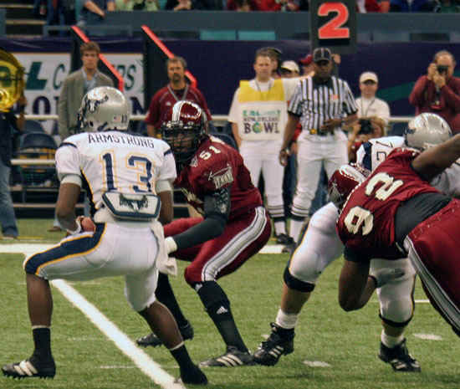
Dynamic, Scenario-Based Training w/Stress Exposure
Skill Acquisition to enhance LEO safety
  Classroom; Range; Simulators; & Simminutions
  Physical Practice
TT+FT+IT= 4 x 4
Design Scenarios & Stress Infusion:
  Cases; Videos; and Agency Reports
  Variability and Unpredictability
    Circumstance & Environment
    Types of Resistance/Behaviors (Armed/Unarmed)
    De-Escalation Techniques
  Situational awareness
  Threat factor analysis & Perception Formation
  Force Option Transition (Use of multiple options in 1 incident)
  Read, React, & Respond (“Read the Play”)
  Feedback & Document

Slide 190
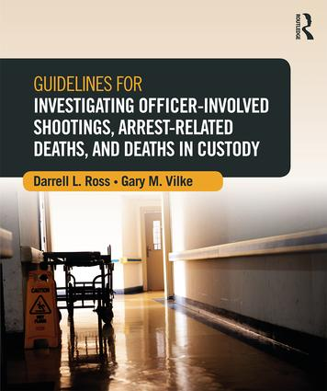
Claims for Failing to Investigate
Monell: Policies, Training, Supervision, Discipline, & Practices
Such failure “ratified” the officer (s) misconduct—led to constitution violation
Did the governmental entity maintain:
  Official policy ?→ Moving force?
  Constructive Knowledge? → Deliberately ignored?
Case examples:
  Salvato v. Miley (‘15): SJ → Outside agency performed investigation (FDLE)
  James v. Harris C0. (‘09): SJ→ Off. found liable; but not Sheriff→ DA conducted investigation
  Backe v. City of Galveston, TX (‘14): SJ Denied → Chief liable
  Harrison v. City of Dickenson, TN (‘13): SJ Denied → Chief liable
  Lee v. City of Richmond (‘13)

Slide 191
Prior to Incident: Supervisor Training Profile
  Dept. Policies, Use of force & Investigation Protocols
  Use of force measures & equipment
  Welfare officer (s): Psychological & Physical First Aid of officer (s)
  Notifications
  Public Safety statement of officer
  On scene Responsibilities & protocols
  Briefing others
  Scene management and integrity→ preserving evidence
  Criminal v. Administrative investigation
  Human Performance Factors
  Legal Issues
  ID witnesses—Statements
  Checklist

Slide 192
Lewis v. City of West Palm Beach (11th Cir. ‘08)
Partially nude & agitated man fought with police
Restrained & hobbled; became unresponsive & died
§1983 claim for excessive force; unconstitutional policy; failure to train; failure to supervise; & wrongful death
Plaintiff challenged the training of applying the hobble
City not on notice that there was a problem using a hobble
Court found no DI to training on using hobble
See also; Davis v. City of Leesburg (‘14):
  Under circumstances, reasonable to use to
  dog leash to hobble ankles of resistant arrestee
  Policy did not prohibit use/application

Slide 193
First Supervisor on Scene
4 C’s & D: Contain; Control; Coordinate; Check; & Document
Attend to involved/uninvolved officer (s)
Notifications (contact list)
Officer public safety statement
Allow officer to contact: family; attorney, Union rep., & PSO
Secure scene & Preserve Evidence [Double Tape]
Keep public/media back
Brief others as they respond
Assign CST to take: GSR; photos/video of officer; retrieve gun belt—preserve
Firearm exchange
Maintain incident scene log→ all personnel
ID Witnesses—gain contact info
Assign PSO to transfer officer to hospital—to home
Checklist → Report

Slide 194
Supervisor Response: Circumstances
Date, Time, & Incident Location
  Primary and Secondary incident scenes
Circumstances
  Dispatch; Self-Initiated; Flagged down
Nature of call and contact
Incident Environment
LEO called back-up; CIT personnel; Supervisor; and EMS personnel
Involved & uninvolved officers (move from scene)
Secure scene, scene security; preserve evidence & photo
Note/Log all personnel on scene
ID Witnesses—gain contact info → Area canvass
Note/Photo LEOs’ injuries

Slide 195
Supervisor Response: Subject’s Behaviors
Subject’s behaviors/actions:
  Appearance and Condition
  Statements and threats
  Behaviors align with Mind-Body Disconnect
  Behaviors align with features of Hyperactive Delirium w/Severe Agitation
  Harmed self or others
  Damaged property
  Type/Degree of resistance
  Injuries
  Photo if still on scene

Slide 196
Supervisor Response: LEO Contact and Apprehension
Verbal/de-escalation used
  Time as a tactic
EHC techniques (Describe)
  Each LEO
IW/equipment used (Collect→ OC Canister; CEW, Probe, Wires, IW, Projectiles)
  Each LEO
Restraints applied (Collect → Handcuffs; Hobble; Flex-cuffs; Restraint Chair )
  Each LEO
Spit mask applied (Collect)
Photos

Slide 197
Supervisor Response: Post Restraint
LEO’s perceived that subject is not, or no longer, an immediate threat
Subject resistance after restraint
  Actions and statements
  Leg restraints applied
LEO monitor subject after restraint
  Position of subject
EMS & Fire requested/when?
Medical attention provided
  LEO and EMS
Subject transport & Location
Hospital treatment and personnel
Collect and preserve subject’s clothing

Slide 198
Supervisor Response: Checklist
Timeline of incident:
  Dispatch
  LEOs’ radio transmissions
  Sup called and on scene
  EMS Run Sheet
    EMS AED, monitors downloads
    Presenting cardiac rhythm
  CEW Data Port (trilogy logs)
  Audio recordings
  ER hospital records
  Sync w/ videos (BWC; Dash-Cam; Surveillance; Phone videos)
Determine duration of phases

Slide 199
Objective Annotated (Confirmed) Incident Timeline
Assists in developing the most accurate, objective, annotated, confirmed, and documented time of events
Dispatched or own initiative
  Collect dispatch recordings, annotated, with time entries, transcribe, VERIFY
“Motorola Memory” (Missy O’Linn)
Activity/Observations over radio
Back-up called → Additional officers on scene → Supervisor on scene
CEW Trigger Pulls (Reference to CEW data port) [Capture “trilogy logs”]
Restrained → “In-Custody” → behaviors after restraint
Duration of capture, control, and restraint
Monitor & render first aid → signs of life to unresponsive
EMS/Fire dispatched (run sheet), on scene, depart, @ hospital, ER, and TOD
Reference w/BWC and Dash Cam video

Slide 200
Force Measures Applied
Incident circumstances (Collect/Preserve ALL Incident Recordings)
Number of present or involved officers
Verbal intervention & de-escalation
Perception of officers
Empty-Hand control techniques
Intermediate weapons
Restraints used & Prone restraint
Order of techniques and restraints used
Duration of struggle
Combination of force measures used (Quantum of Force)

Slide 201
CEW Application
Model type
Probe or Drive Stun
  Distinguish drive, contact, or touch
# Trigger pulls and duration of cycles
Distance deployed
Effects on decedent
Spread of wires
Location on body
Time from application to collapse
Actions after activation
Unusual current flow paths
Collect, assess, & Retain probes/wires
Collect/preserve unit w/battery
Spark tests
Unit operate correctly
Quickly correct time drift
Data printout
Compare printout w/other case info

Slide 202
Restraints Used
Decedent prone and duration
Number of officers
Restraint type: Cuffs, Hobble, Restraint Chair or Bed)
Number of restraints used
Collect restraints
Photo of restraints
Statements of decedent (post)
Resistance of decedent (post)
Prone, on side, sat up
Radio transmissions (collect)
Officer monitoring
When unresponsive?
Officer medical intervention
EMS summoned, arrive, intervention?
EMS run sheet w/report
Transported
Behaviors & statements during transport
Interviews
Develop OBJECTIVE Time Line
Ongoing file

Slide 203
Officer’s Report: Checklist
BWC as best objective documentation
Approach & Observations
Circumstances-Nature of Call—Dispatached
Operating Environment
Subject Behaviors & Statements
Appearance & Condition
Types of Resistance/Threat Level
Describe subject capacity to respond
Describe Perception: POV
Role in incident
Arrest or Protective Custody
Describe de-escalation used→ Verbal used
Subject had/used weapon/access to weapon
Describe when Back-up; Sup; CIT & EMS called & Responded
Rationale for all use of force used
Reaction Time
ID & Justify all control techniques used
ID & Justify IW & Restraints Applied
CEW Mode & Trigger pulls
CEW Probe/DS Locations
Duration restrained prone
CEW applied while prone
Position after restraint
Describe Monitoring
Post-Restraint Resistance & Force applied
Discharge firearm
Describe Medical attention
EMS Treatment
“Motorola Memory” (Radio)
Describe subject injuries
Describe officer injuries
Officer Transport
EMS Transport & Officer accompany

Slide 204
Use of Force Review---FIT
Review video & audio
Officer’s report
Other officers reports
Officer (s) injured
EMS report
Witness reports/interviews
Other officer witnesses
Arrestee statement
Initial supervisor report
Review RTR policy
Assess all force techniques
Assess all force equipment used
CEW data port print-out
Nature of the incident/Circumstance
Operating environment
Arrestee resistance v. force applied
Totality of circumstances
Human factors and reaction time
Interview officer(s)
Subject injury/medical provided
Medical provider’s reports/EMS
Citizen complaint
Force training→ Interview force instructor
LEO training history/records
Violation of training
Violation of policy
Report submitted

Slide 205
11th Circuit Deadly Force Decisions & LEO Perception
Subject used vehicle as weapon; SJ granted:
  Tillis v. Brown (2021); Long v. Slaton (2007) Tense & dangerous situation, officer not required to wait for suspect to shoot, to use deadly force; McCullough v. Antonlini (2009); Troupe v. Sarasota, Co. FL (2005); Terrell v. Smith (2012); Thomas v. Durastanti (2010); Robinson v. Arrgueta (2005); & Webster v. Beary (2017)
Immediate threat w/weapon; SJ granted:
  Montoute v. Carr (1997); Garczynski v. Bradshaw (2009); Penley v. Eslinger (2010) & Quiles v. City of City of Tamp, PD (2015)
Limited reactionary time; SJ granted:
  Nicarry v. Cannaday (2007)
Hoefling v. City of Miami (2016): Shot @ fleeing vehicle; Robbery suspect had gun w/hostages in vehicle; LEOs shot 24 rounds, injuring hostages
  Reasonable force→ Emergency Exception
  Posed a threat & TofC
  No deficiency in dept. policy or training
  SJ granted

Slide 206
11th Circuit Force Analysis
Murphy v Demings (‘15) SJ; furtive movements @ waist, believe going for gun; posed immediate threat--ORF
Quiles v City of Tampa PD (‘15) SJ; Active struggle; believed had gun— not required to wait to use LF
Flowers v Jackson (‘14) L-LF, CEW & SJ; AR, ignore verbal; Posed threat, CEW reasonable & force proportionate
Gacynzski v Palm Beach Sheriff’s Office (‘09): SJ; Suspect refused to drop gun, stepped; officer shot; ORF
McCormick v. City of Fort Lauderdale (‘03) CEW applied & SJ granted
Draper v. Reynolds (‘04): CEW applied & SJ granted
Zivojnovich v. Barner (‘08): SJ granted
Moretta v. Abbott, et. al (‘08): LEO CEW on a 6 year old boy holding a piece of glass in hand & despondent; No QI, conduct of officer “clearly obviously unlawful”
Jones v. Fransen, Towler, Ross & Gwinnett Co., 857 F.3d 843 (11th Cir. ‘17)
  No excessive force when K-9 used

Slide 207
11th Circuit-- CEW and ARD
Oliver v. City of Orlando and Fiorino (M.D. FL. ‘11)
  Violent; CEW 8 TP, Cocaine/ExDS (108°); Prone restraint & died → SJ granted
Estate of Gilliam v. City of Prattville, et al. (11th Cir. 2011)
  Resist and CEW 3-4 TP; died→ SJ granted
Hoyt v. Cooks (11th Cir. ‘12)
  DS 3 TP during cuffing and MI; violent resisted; died → SJ granted
Callwood v. Jones (11th Cir, ‘18)
  Violent; ExDS; CEW 14 TP; Prone restraint, Hogtied; Died → SJ
Bussey-Morice v. Gomez (11th Cir. ‘14)
  ExDS/psychotic; fought w/officers; CEW 3TP → SJ granted
Marquez v. City of Phoenix (9th Cir. ‘12) (child exorcism case)
  ExDS/Violent; CEW 22 TP in PM & DS; died of heart disease → SJ granted

Slide 208
11th Circuit--Restraint Asphyxia Case Decisions
Owens v. City of Atlanta, 780 F.2nd, 1564 (11th Cir. 1986)—SJ granted
Cottrell v. Caldwell (11th Cir., ‘96) SJ granted
Fernandez v. City of Cooper City, 207 F. Supp. 2nd 1371 (11th Cir. 2002) SJ
Bozeman v. Orum, 199 F. Supp. 2nd 1216 (11th Cir. 2002) SJ
Owens v. City of Fort Lauderdale, 174 F. 2nd 1282 (S.D. Fla. 2002) SJ denied
Garrett v. Unified Government of Athens-Clarke County, 378 F. 3d 1274 (11th Cir. ‘04)—SJ--Hog-tied arrestee who had a head wound and had been sprayed with pepper spray, and violent resisted, restrained wrists and ankles 12” apart

Slide 209

11th Circuit --Restraint Asphyxia Case Decisions
Vinyard v. Wilson, 311 F. 3d 1340 (11th Cir. 2002) SJ denied
Jackson v. City of Albany, GA, 49 F. Supp. 2nd 1374 (M.D. Ga, 2011) SJ denied
Bussey-Morris v. Kennedy (11th Cir. ‘16): SJ granted→ CEW and 4-point restraint
Davis v. City of Leesburg Borders et al. (M.D. FL. ‘14) SJ granted—4-point restraint w/dog leash on violent arrestee, legs were secured less than 90° angle—No death Under circumstances, reasonable to use to dog leash to hobble ankles of resistant arrestee; Policy did not prohibit use/application
Lewis v. City of West Palm Beach (2009): Crt. SJ→ “Although unfortunate, it is not unconstitutional for an officer to place his knees on the back, hobble & restrain a combative arrestee even though he died, and such technique is objectively reasonable”

Slide 210
Administrator’s Question & Requirement
Quis Custdiet Ipsos Custodes?
Who will guard the guardians?
Administrators & Supervisors must!
Places agency in best position to lead the department
Places agency in the best position to defend against a lawsuit

Slide 211
“What should drive CJ organizations more than fear of a lawsuit, is the commitment of excellence and the desire to promote leadership and professionalism in the organization”(M. Brave, ‘00)
“The growth and development of people is the highest calling of leadership”
Harvey Firestone

Slide 212
Recommended Websites
Americans for Effective Law Enforcement www.aele.org
Institute for Prevention of In-Custody Deaths www.ipicd.com
Legal & Liability Risk Management Institute www.llrmi.com
Police Executive Research Forum (PERF) www.policeforum.org
US Supreme Court www.supremecourtus.gov/opinions
Police One and Corrections One www.policeone.com
Lexipol www.lexipol.com
Int’l Law Enforcement Ed/Trainers Association www.ileeta.org
National Tactical Officers Association www.nato.org
Find Law www.findlaw.com
FBI www.fbi.gov
Axon www.axon.com
American Jail Association www.americanjail.org
GA Chiefs Association www.gachiefs.com
GA Sheriff’s Association www.gasheriffs.org

Slide 213
Available Resources
Active Bystander for Law Enforcement, training program (2021, ABLE) Georgetown University Law Center: www.law.Georgetown.edu/cics/able
EPIC training program (2021). Ethical policing is courageous. New Orleans LA PD, www.epic.nola.gov/home
IACP (2021). Peer bystander intervention in law enforcement agencies, www.theiacp.org
Kaufman, Z. (2024). Officer duty to intervene laws. www.zacharykaufman.com/projects/officer-duty-to-intervene-laws/?sortByDate=true
LEXIPOL (2023, Nov.). Duty to intercede. www.info.lexipol.com/uofm/position_Lexipol_Duty-to-Intercede.pdf
Morin R, et al. (2017, Jan.) Behind the badge. Pew research center. www.pewsocialtrends.org
Police1 (9/22/21). Police performance: Developing a culture of accountability. www.police1.com/police-performance/articles/digital-edition-developing-a-culture-of-accountability-trBMm6qA8KEWHvgM/#Fill%20out%20the%20form
Ross, DL (9/24). Liability issues for failure to intervene. AELE Liability Reporter. www.aele.org
Ross, DL (2023). Civil liability in criminal justice. Routledge Publisher.

