Slide 1
MASLENITSA
SEPTEMBER 2019

Slide 2
What is Maslenitsa?
Maslenitsa is one of the oldest surviving Slavic holiday. The festival combines pagan and Orthodox traditions. It originated as the pagan New Year celebration welcoming the arrival of spring, bringing together families, commemorating the dead, and eating pancakes! Pancake, the symbol of the holiday, is the representation of both– the sun in the pagan tradition, and the last opportunity to enjoy butter, milk, and eggs before the Lent, as meat is already forbidden by the beginning of Maslenitsa. Usually Maslenitsa lasts for seven days and on the last day of this holiday people burn a doll which is made of branches and straw and dressed in bright clothes. This doll is called “Maslenitsa” and it symbolizes the cold and severe winter. By burning “Maslenitsa” people say goodbye to winter and greet a warm spring

Slide 3
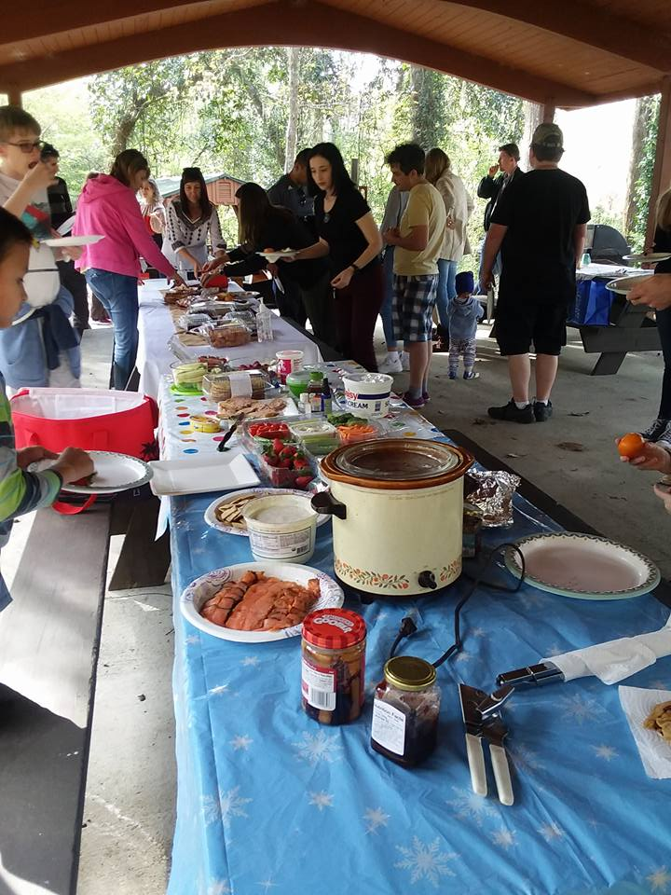
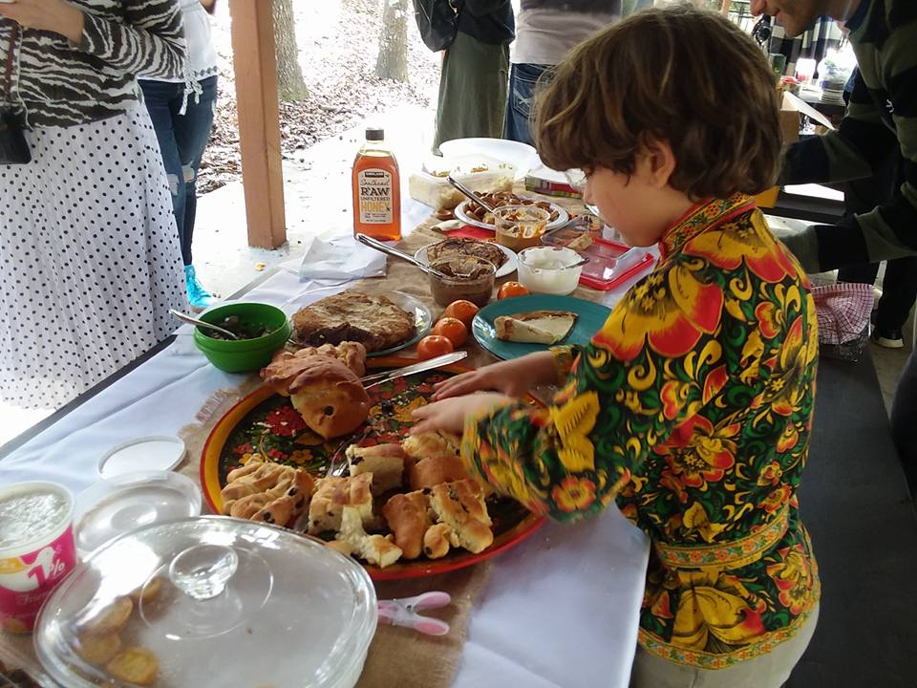

Slide 4
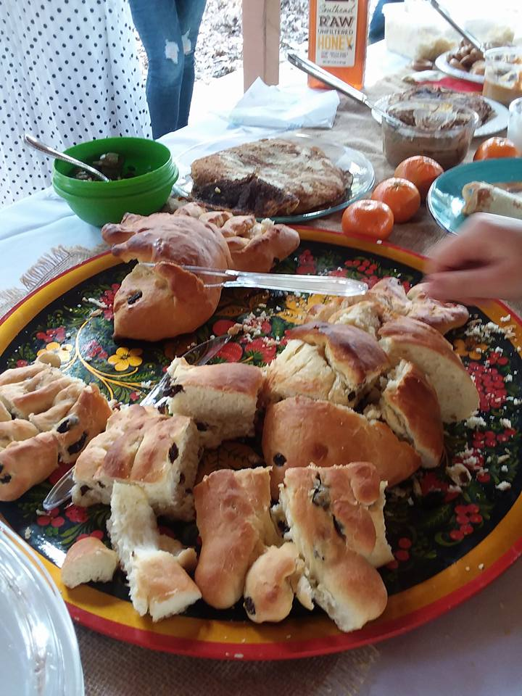
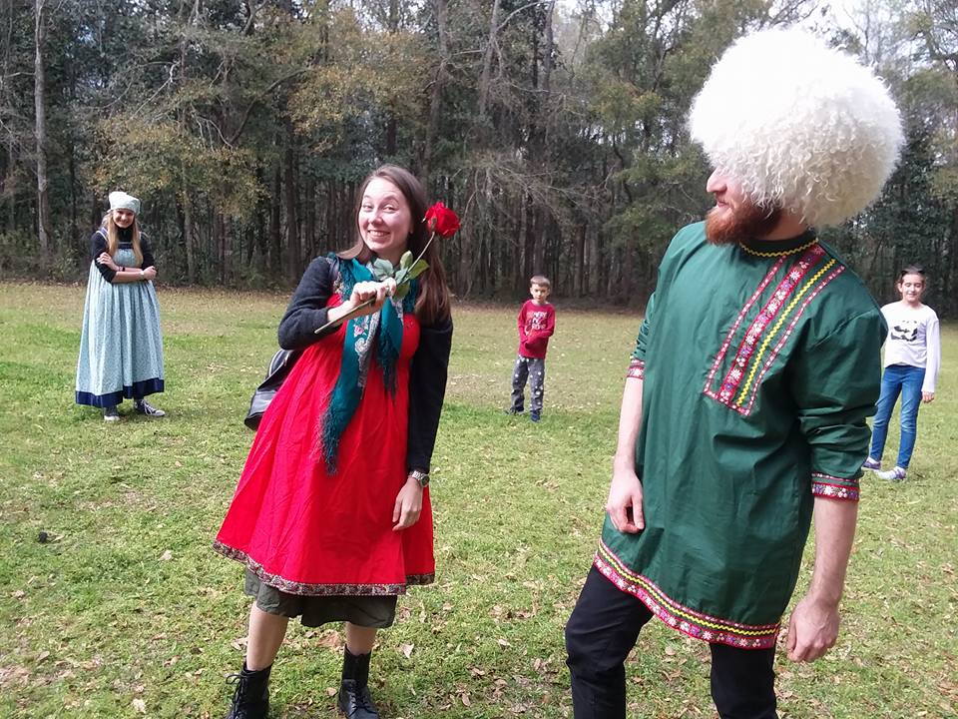

Slide 5
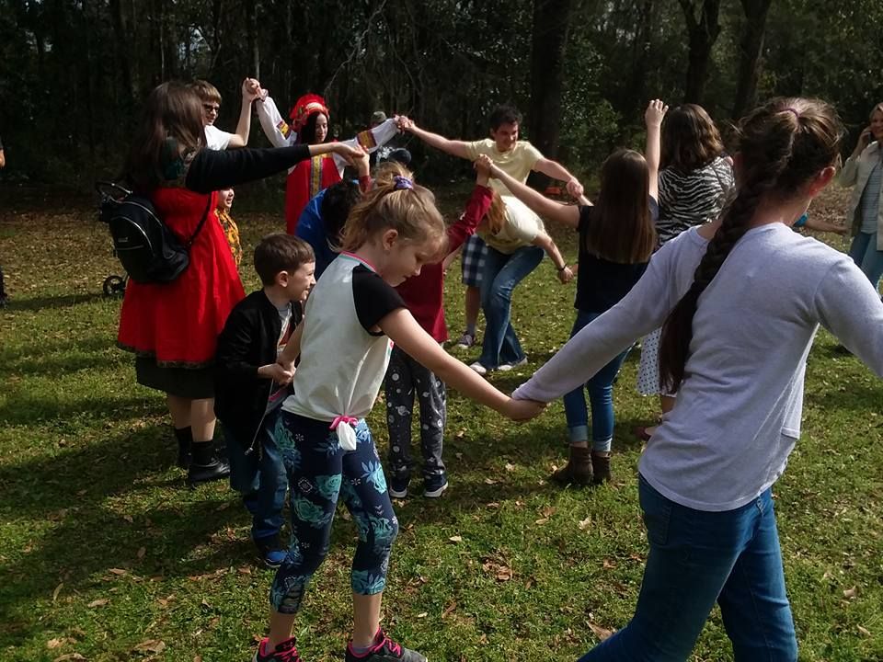
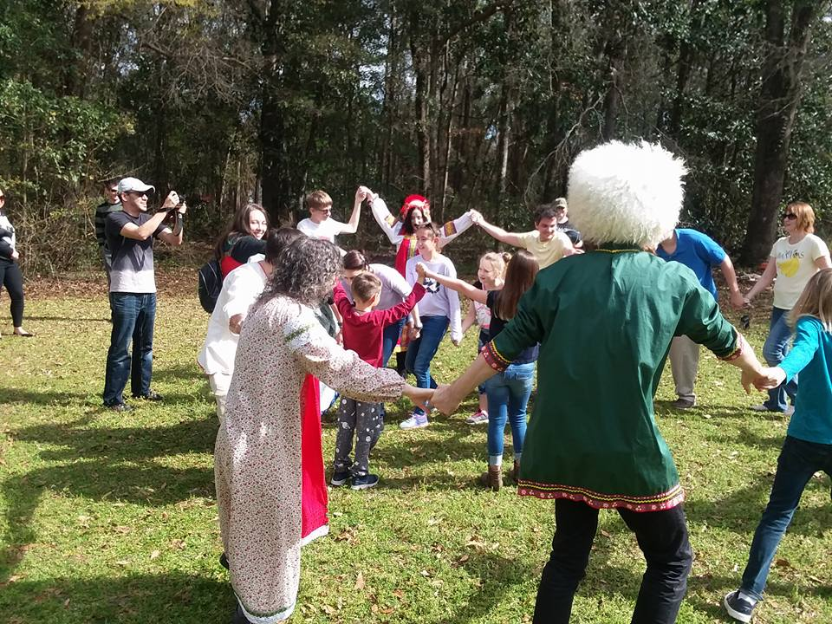

Slide 6
