Slide 1
HISPANIC HERITAGE MONTH KICKOFF
SEPTEMBER 2022

Slide 2
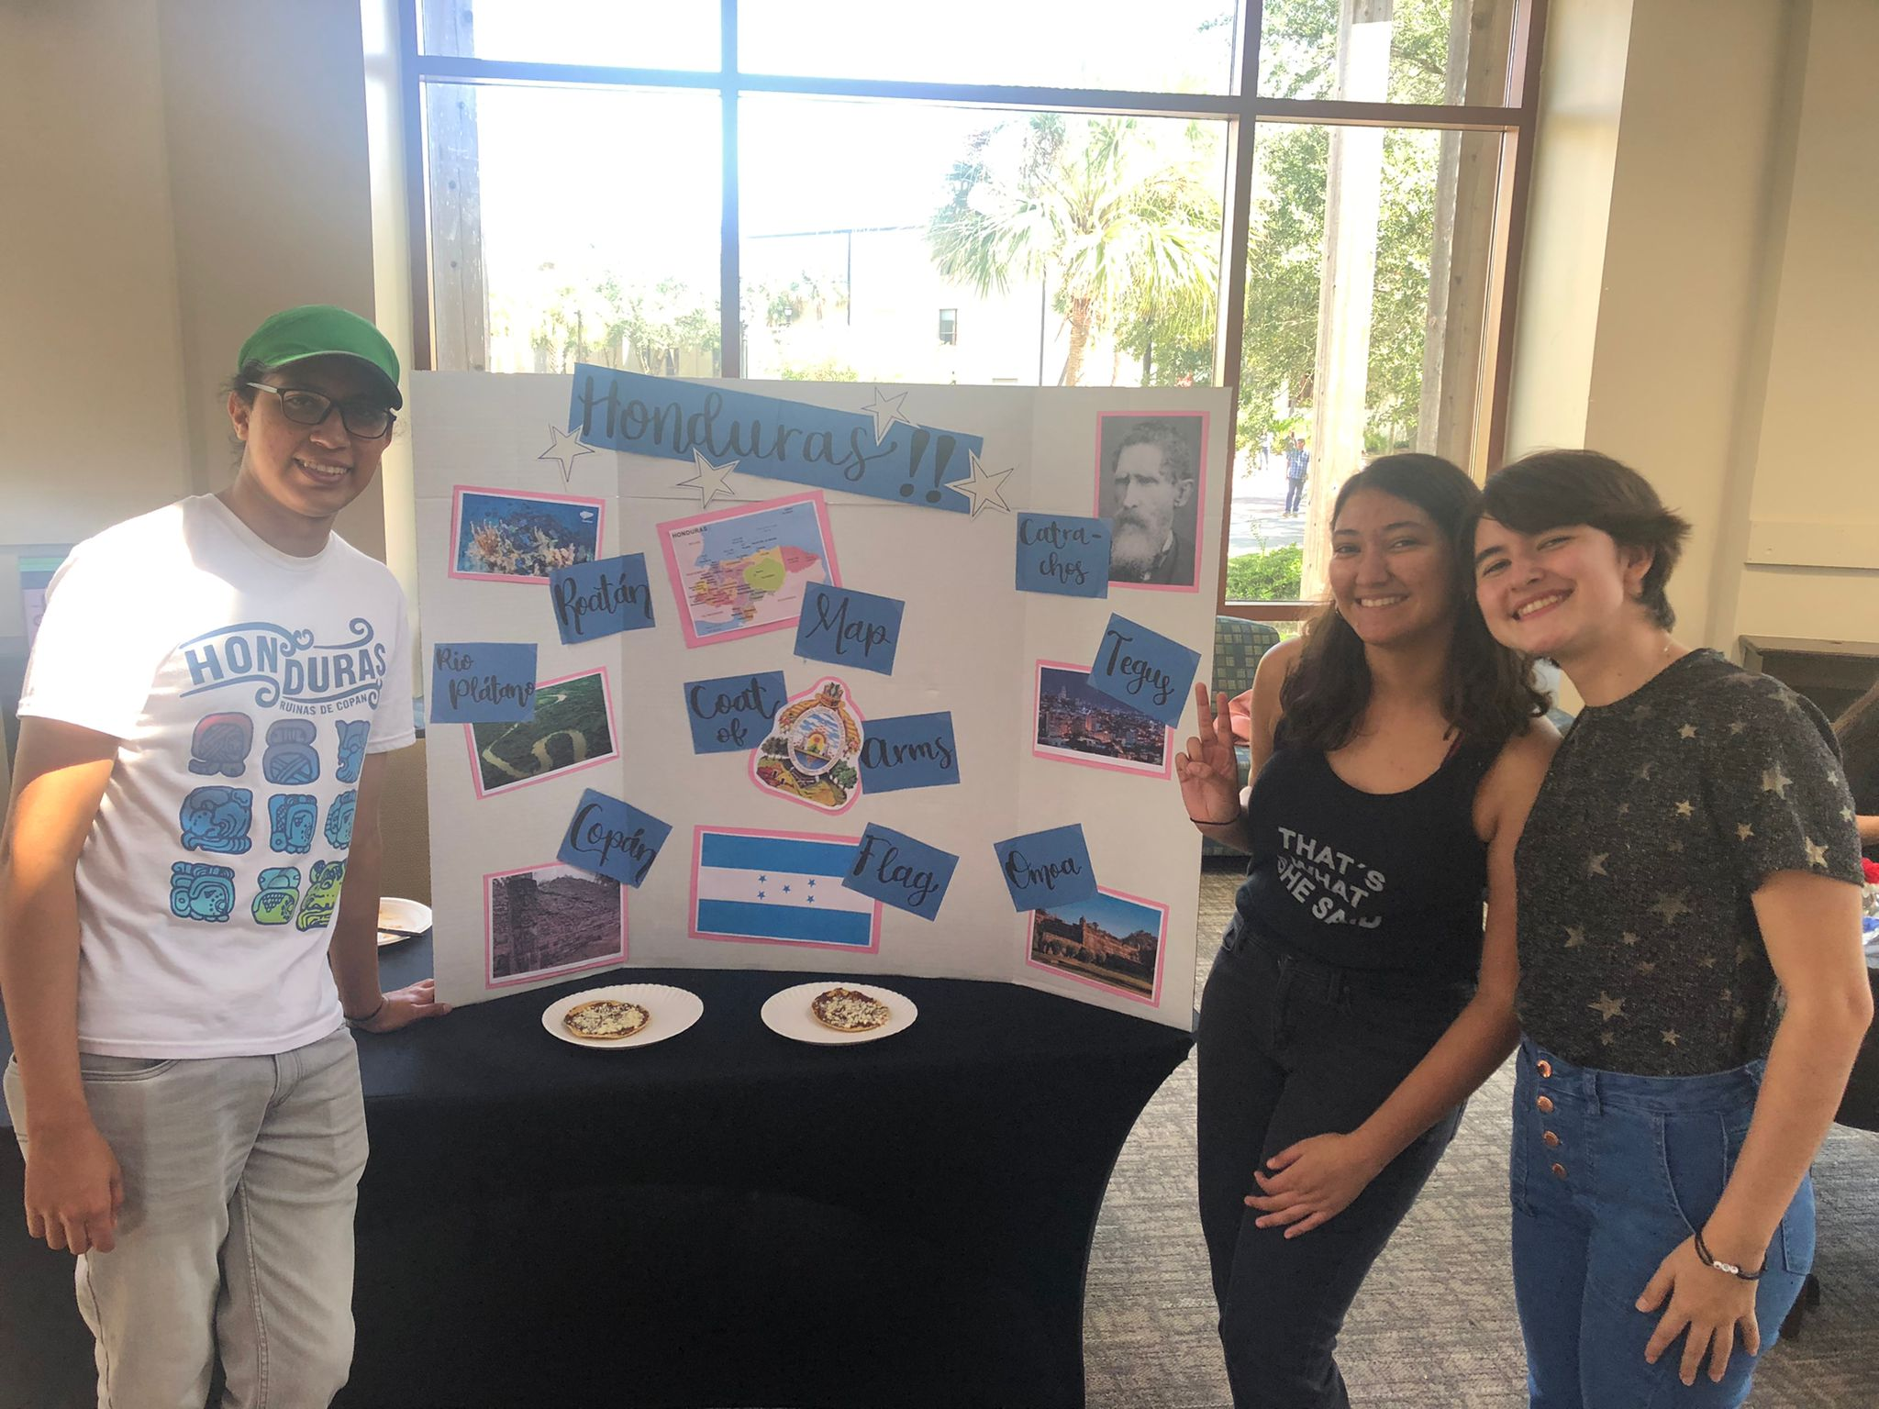

Slide 3
